Slide 1
Tropical Catchment
Case study Philippines

Slide 2
Contents
River basin action plan (Questions about text)
Introduction Philippines (video clip)
Catchment / Watershed
Tropical watershed landscape (video clip)
Tropical basin use (video clip)
Example management action: flood risk early warning system.

Slide 3
Introduction
Film 1

Slide 4
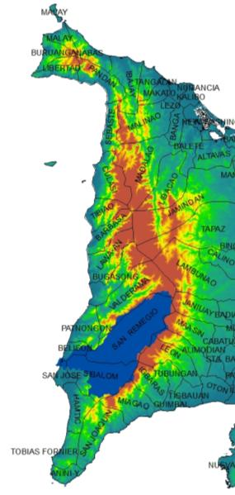
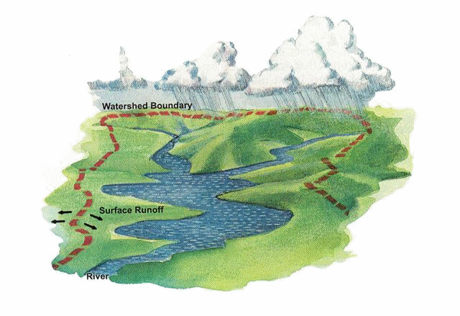
watershed
Notes:
3d pan van watershed op antique bergen.

Slide 5
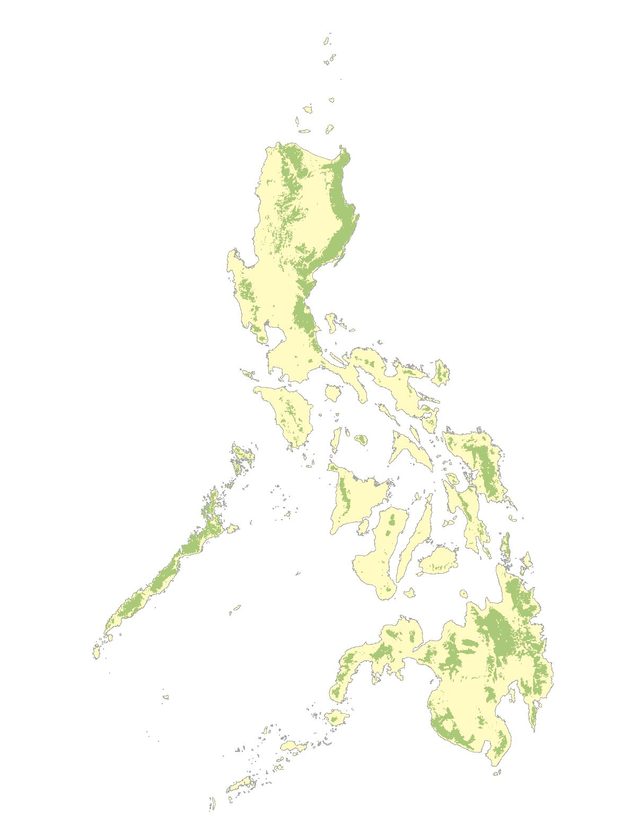
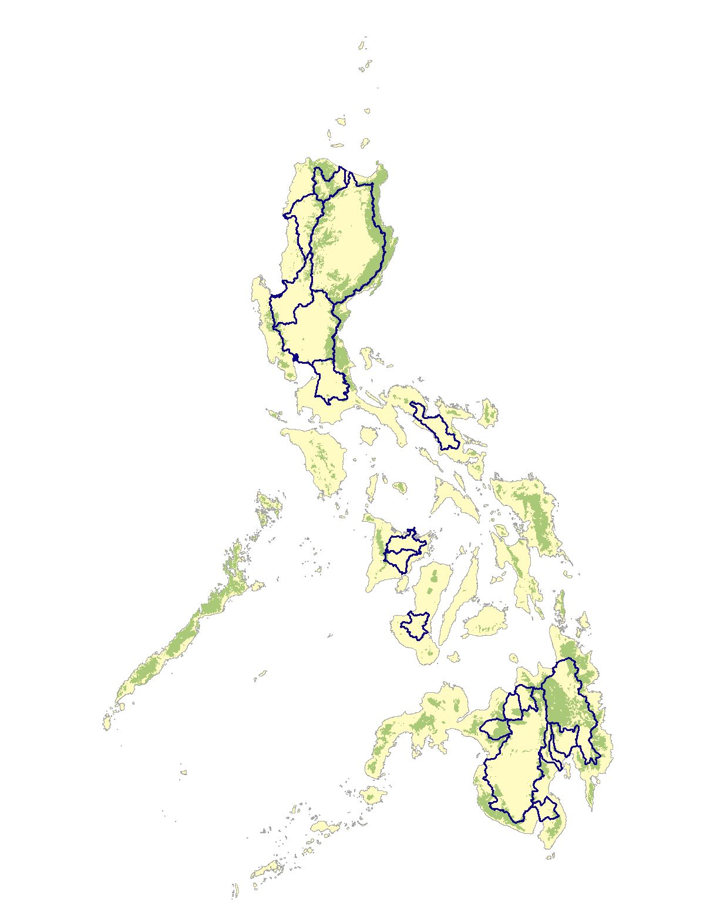
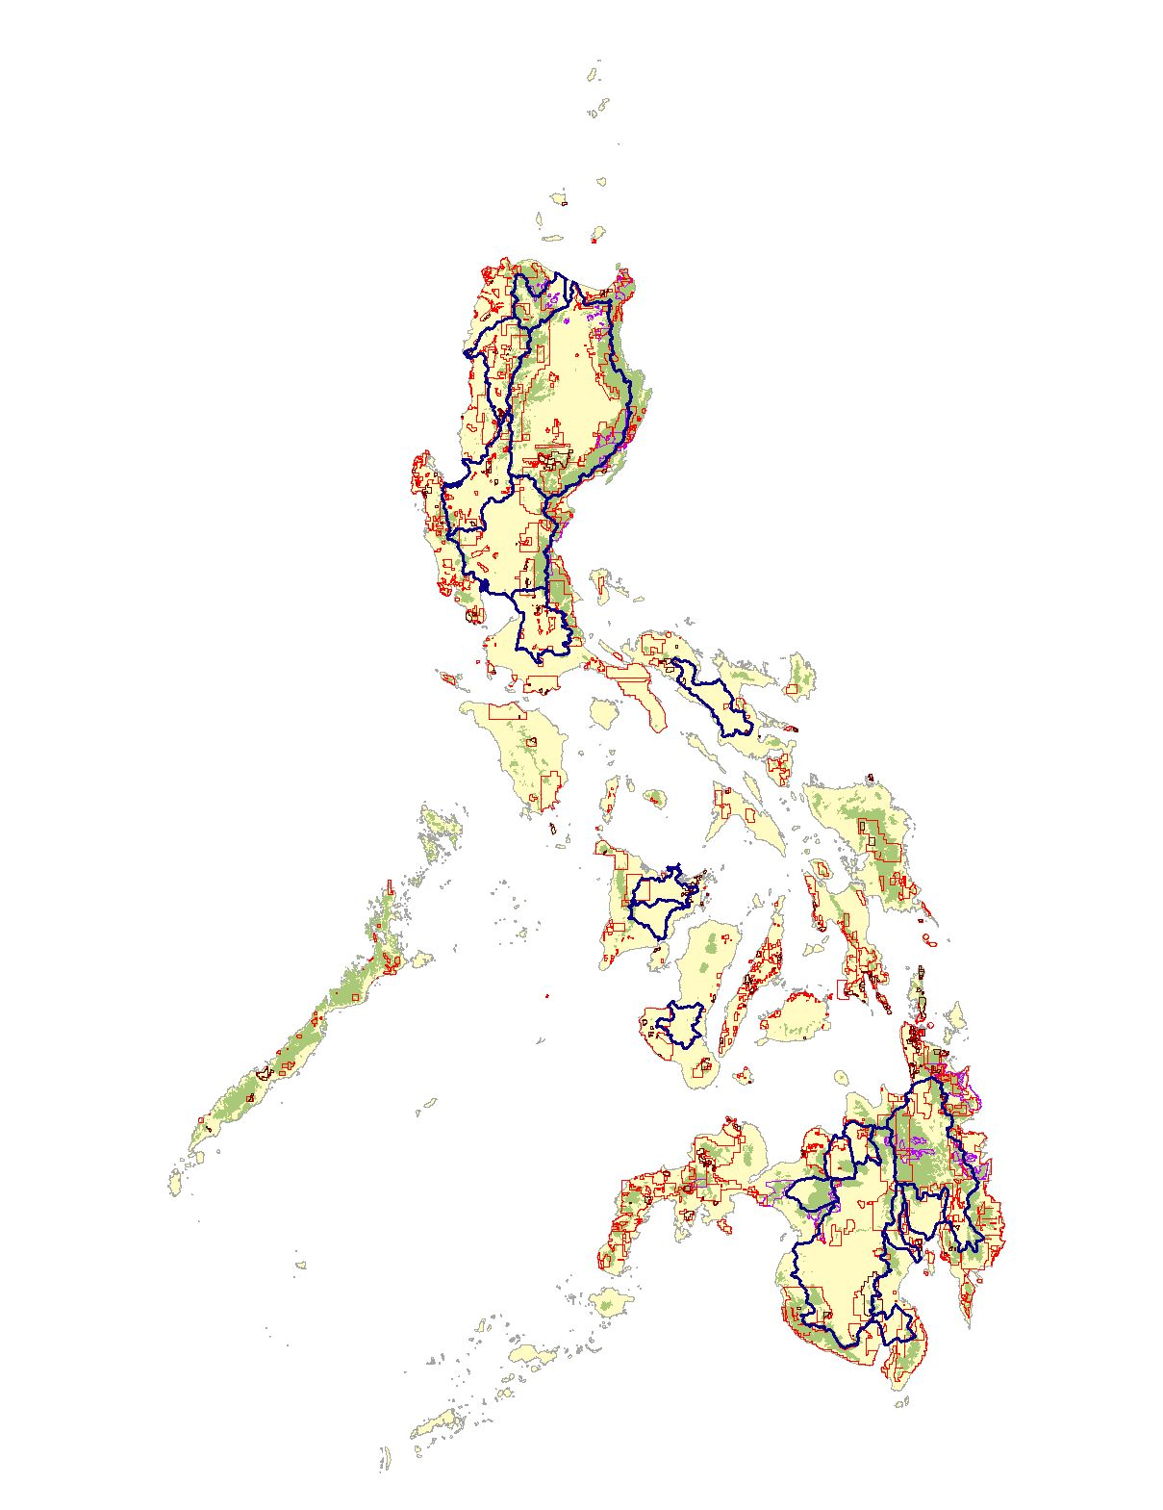





Watersheds

Slide 6
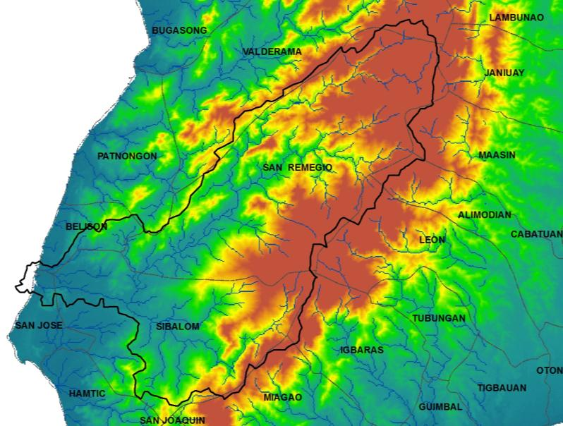
Drainage network
Sulu Sea
Notes:
Titel veranderen: drainage network. Maak duidelijk wat grote en kleine plaatjes zijn.

Slide 7
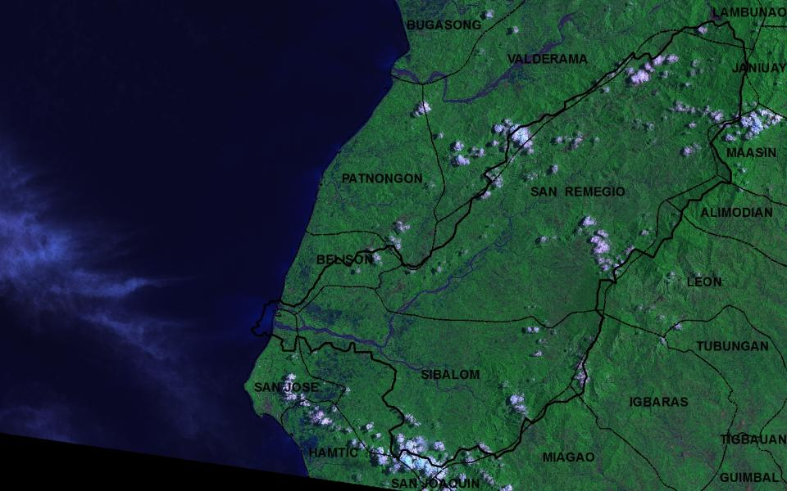
Sibalom watershed – indication of scale
Key facts
Area | 66500 Ha
Highest point in watershed | 1584
Length Sibalom river to source | 70 km
Municipalities (also partly) | 7 / 13 (including Iloilo side)
Barangays (also partly) | 135
Sulu Sea

Slide 8
Watershed landscape
Film 2

Slide 9
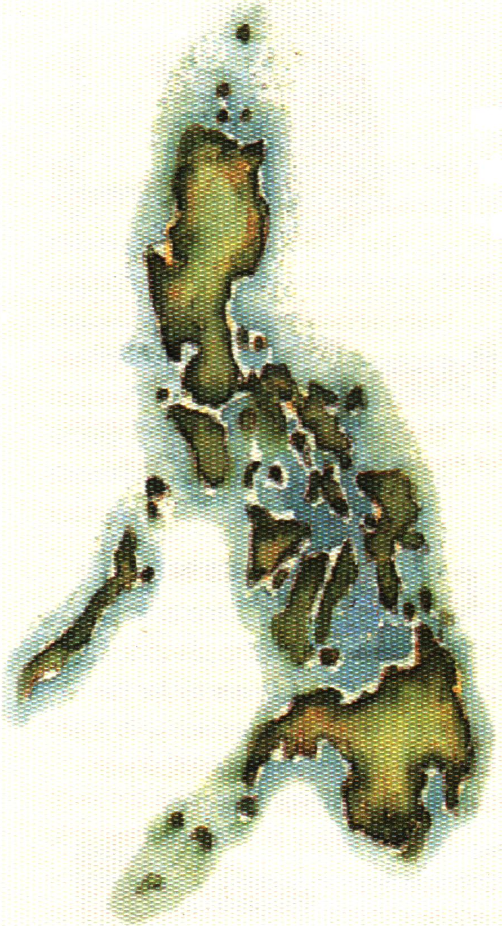
Philippines
LAND USE STATUS
Forest land 18.1%
Residual
forests
2,731,177 ha
(includes forests on ultramafic and limestone rocks)
Sub marginal forests
475,100 ha
Brush land 7.4%
Mangrove forests
112,400 ha
(includes brackish water forests)
(includes lowland evergreen, semi-evergreen, and moist deciduous rain forests)
Other Land use 74.5%
Mossy forests
1,040,300 ha
(includes the upper montane and subalpine rain forests)
Pine forests
227,900 ha
(lower montane rain forests)
Forest Formations
in the Philippines
Old growth forests
804,900 ha
(lowland evergreen rain forests)
DENR FMB 2000
based on 1997 data

Slide 10
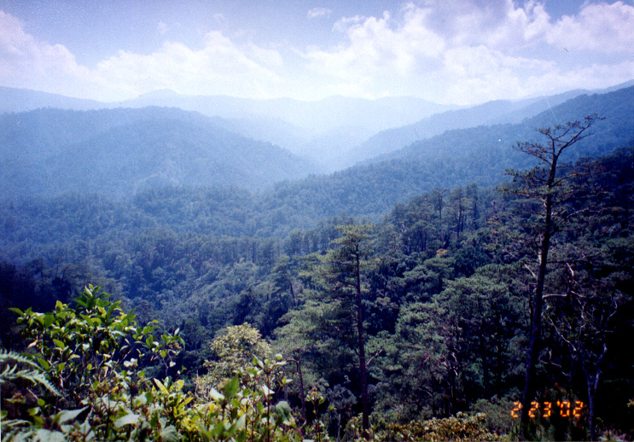
Major Watersheds
The Philippines has 18 identified major river basins
13 out of 18 major river basins have forest cover below 20% of its total area

Slide 11
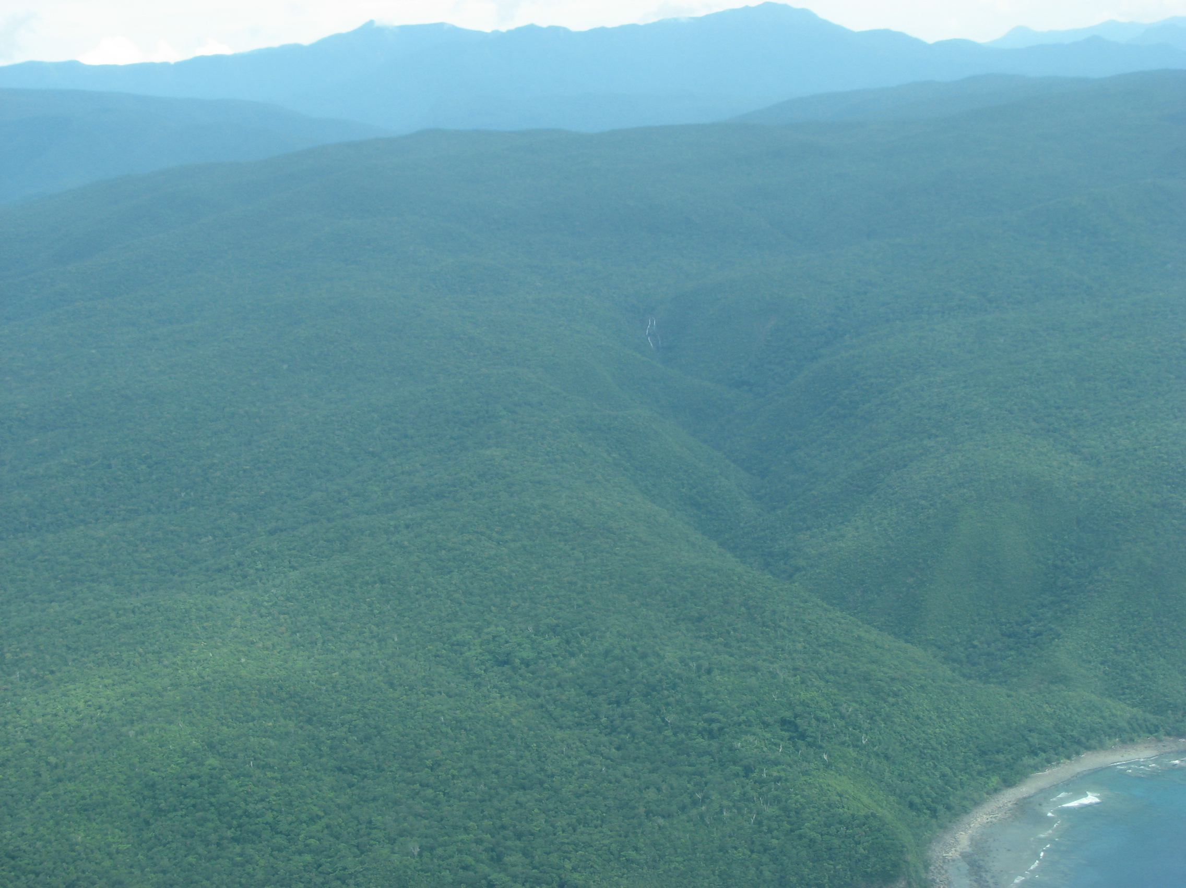

Slide 12
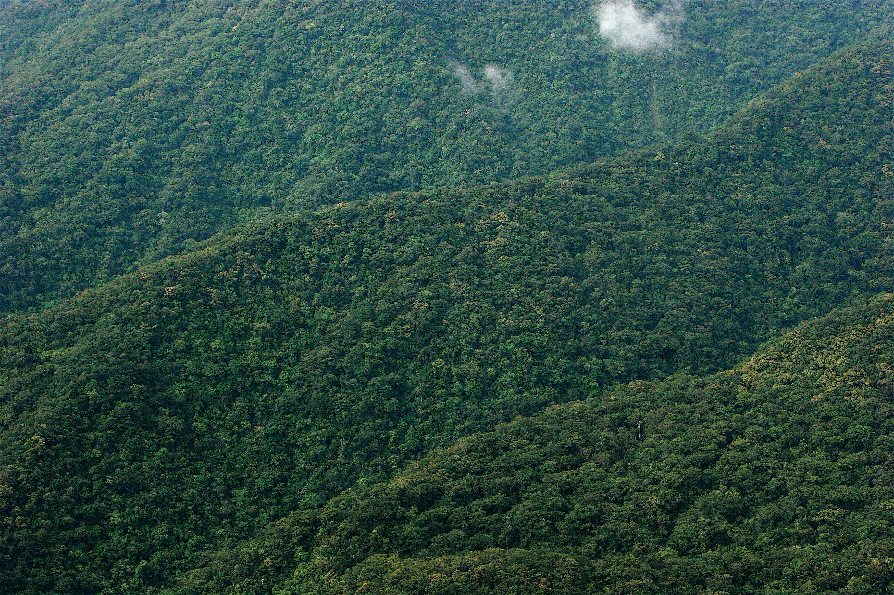

Slide 13
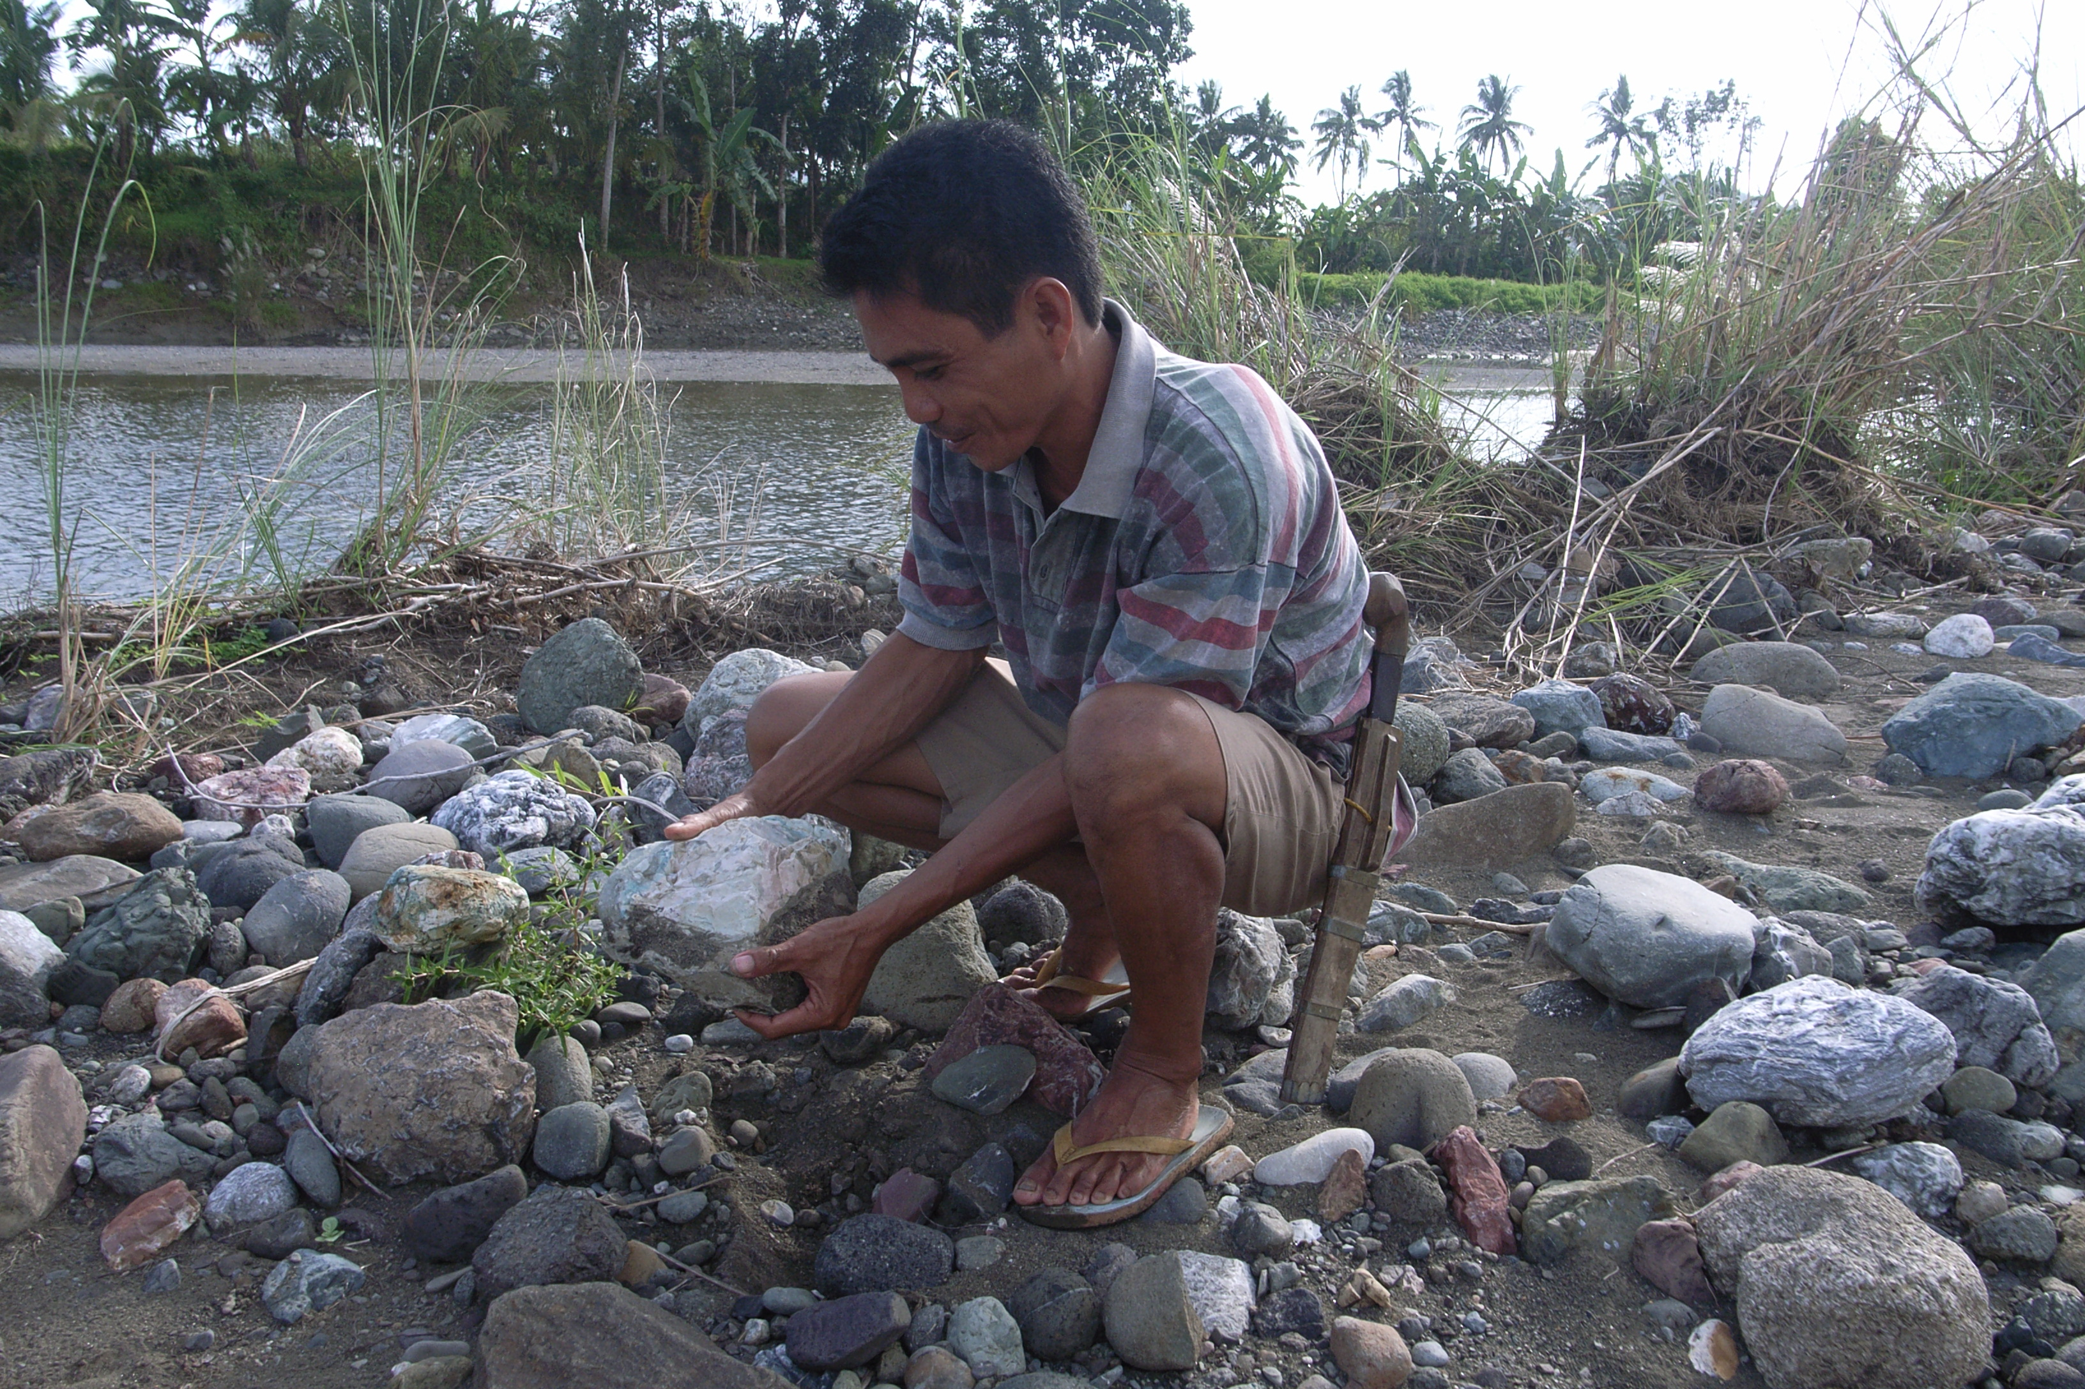
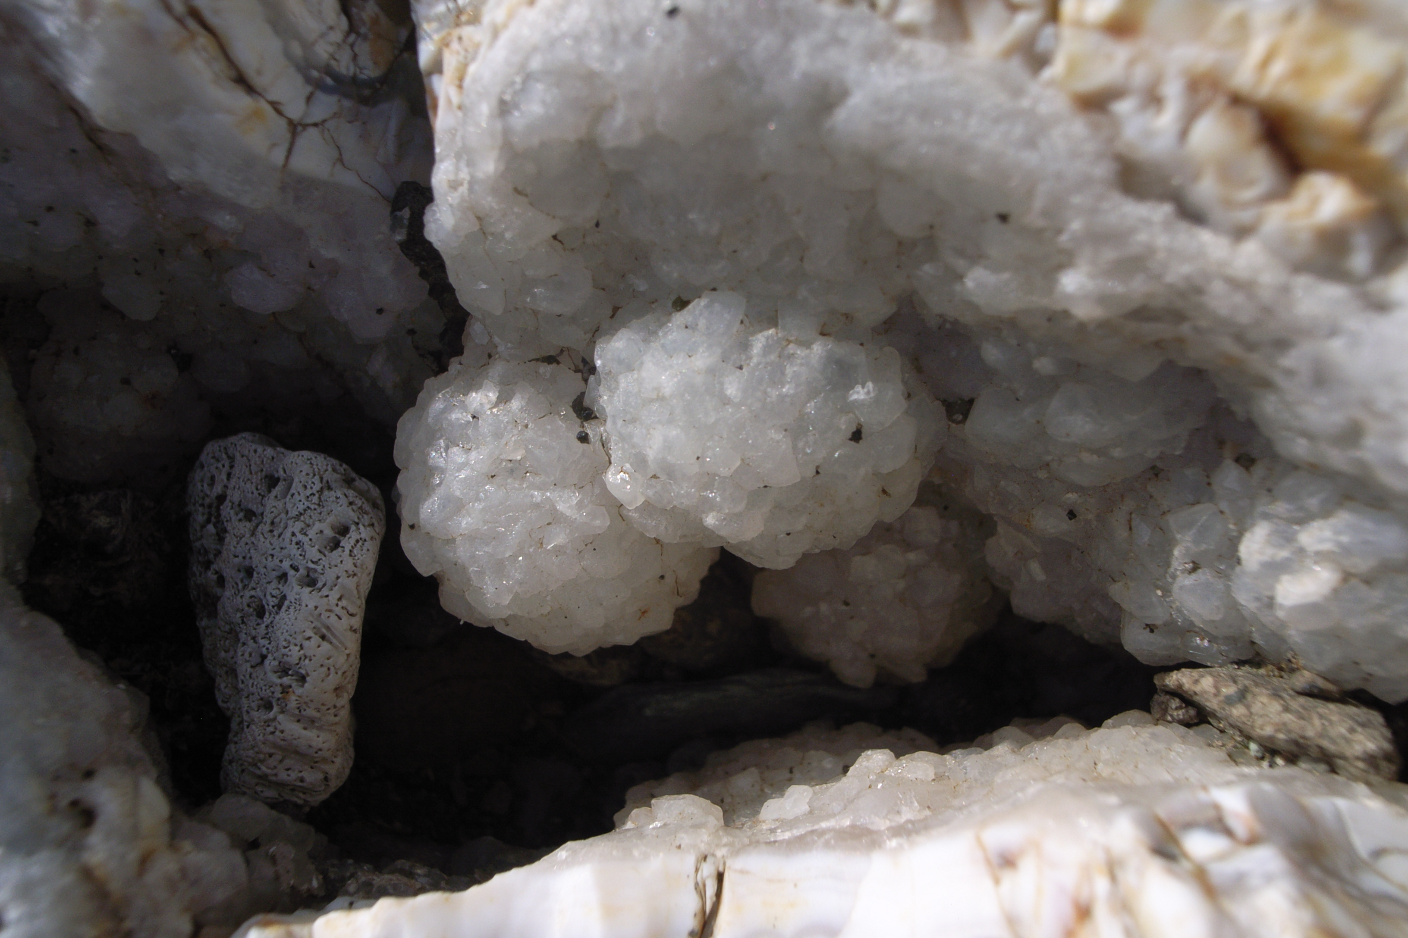
Ecosystem services
Gemstone gathering

Slide 14
Ecosystem services
Film 3

Slide 15
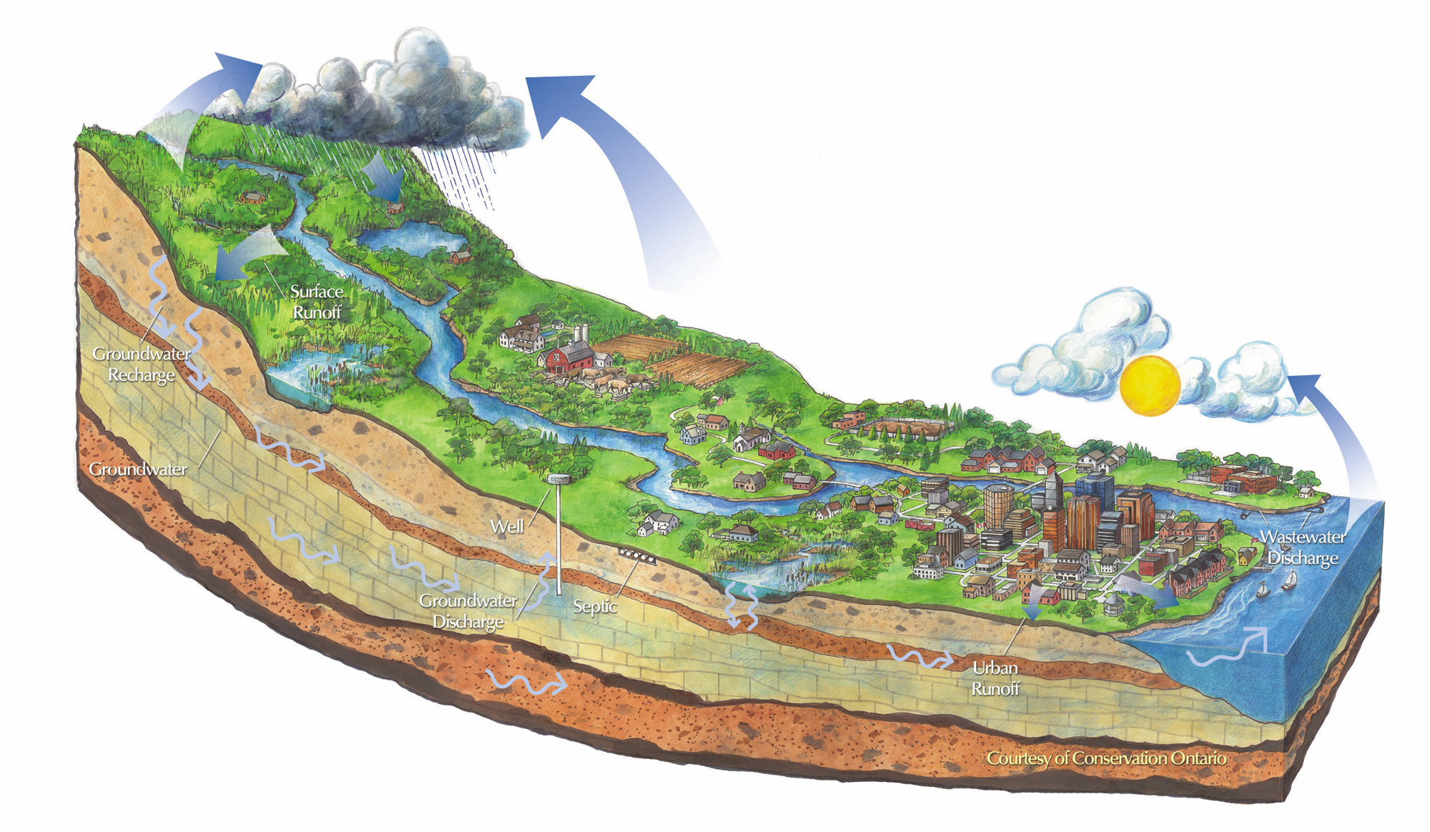
Watershed sevices

Slide 16
Watershed sevices

Slide 17
Watershed sevices

Slide 18
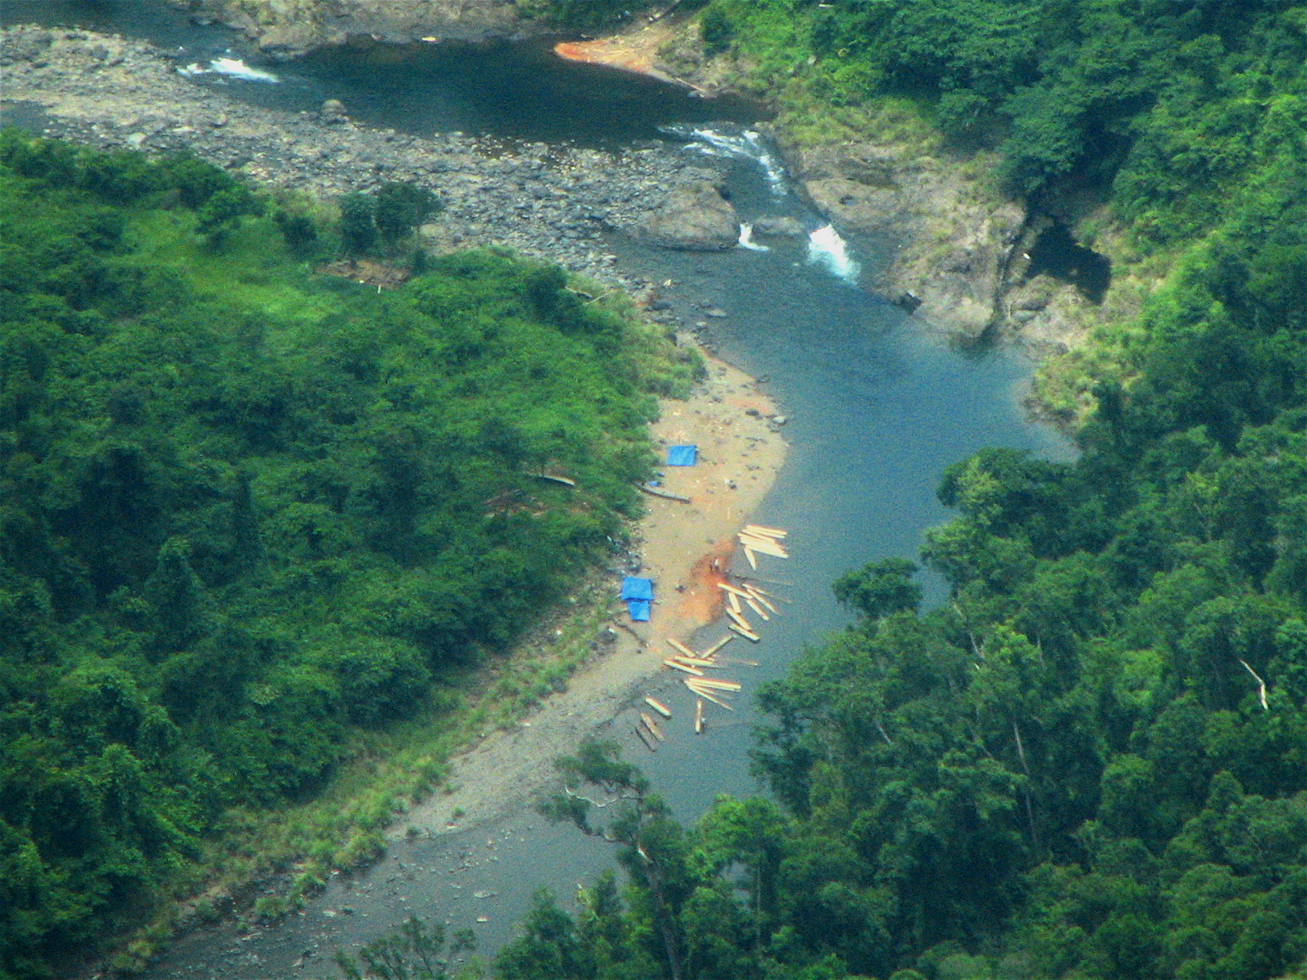
Illegal logging

Slide 19
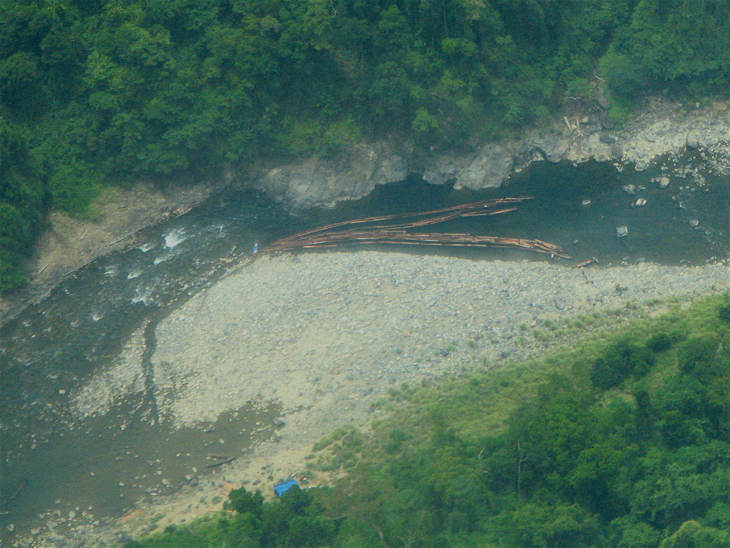
Illegal logging

Slide 20
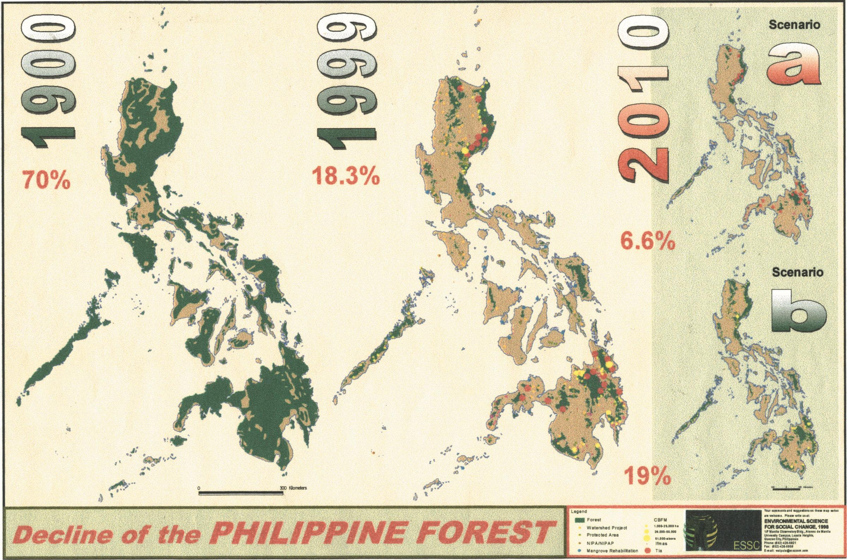

Slide 21
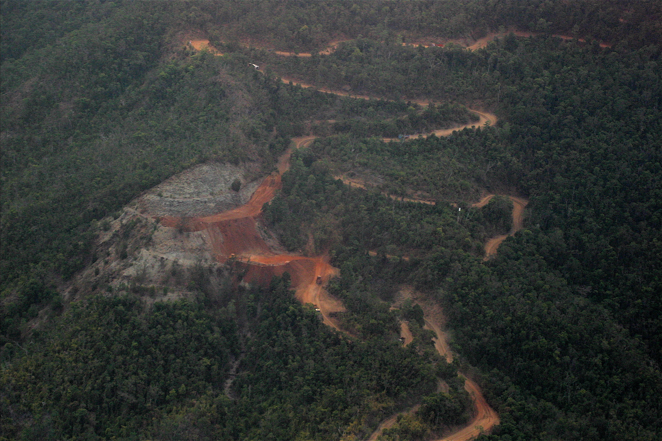

Slide 22
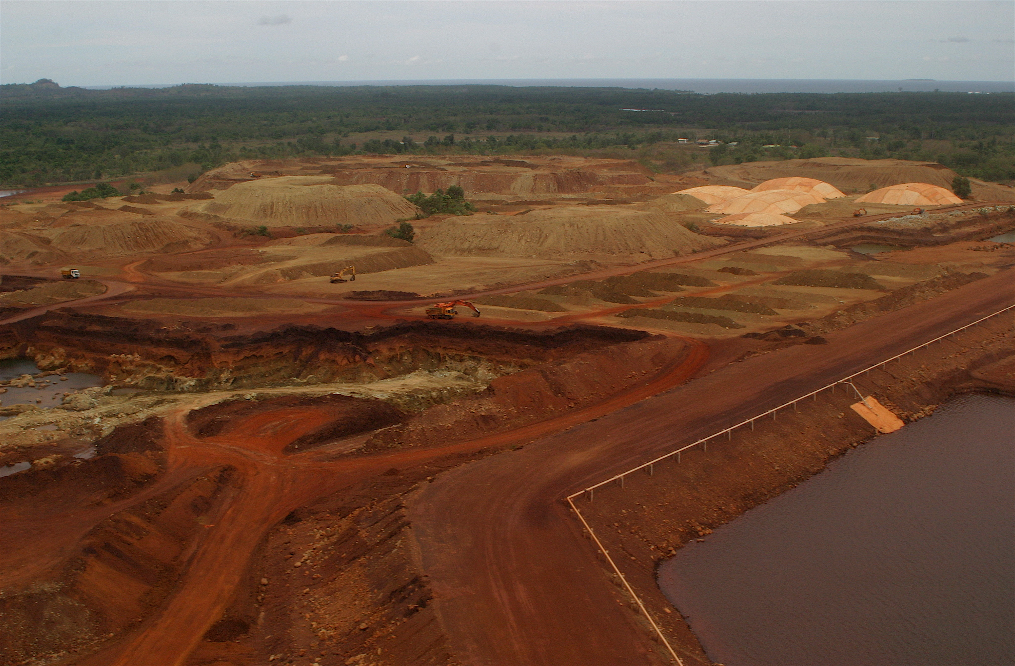

Slide 23
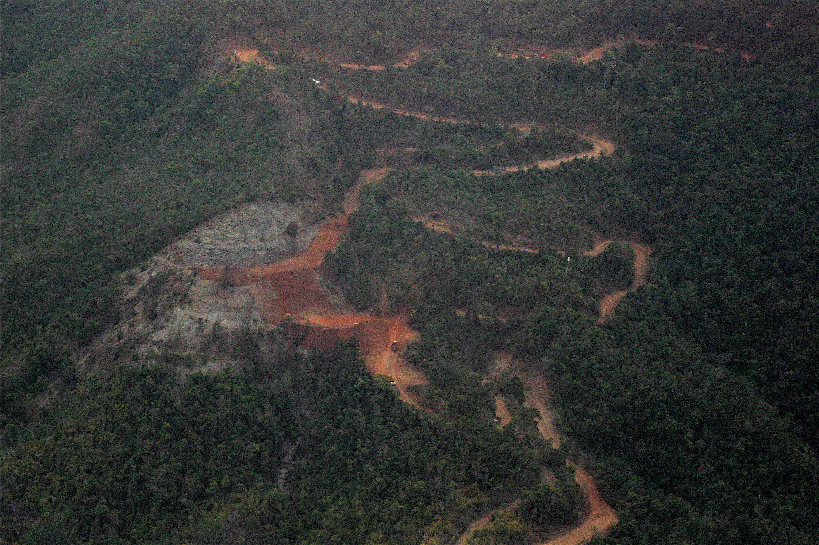
Small Scale Mining Operation

Slide 24
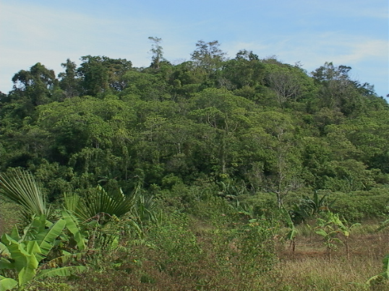
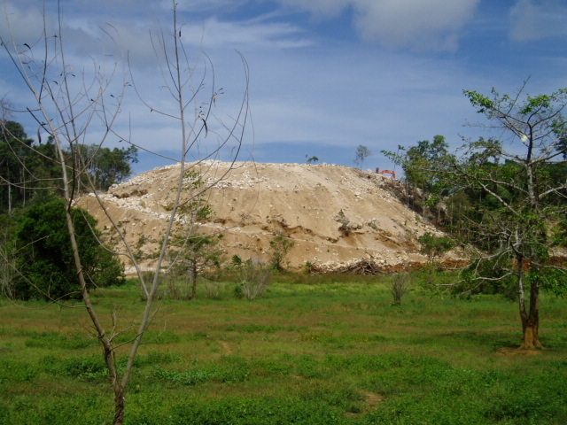
Limestone Quarry Site
Before
Now
See more on Mining powerpoint on ftp drive (Toine)

Slide 25
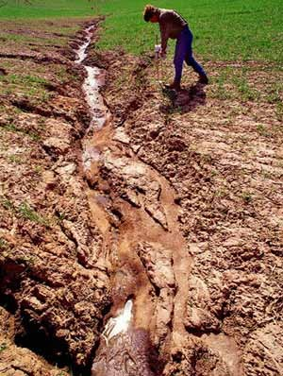
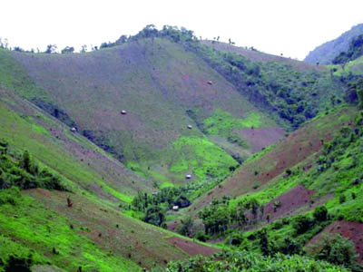
Soil erosion
Soil erosion depletes soil productivity for future generations.
Soil erosion increases the sediment carried by rivers, and can increase its lateral movement.
Soil erosion blocks downstream irrigation channels.
Soil erosion increases sediment input in coastal areas, causing siltation that affects for example coral reefs.
….... (more?)

Slide 26
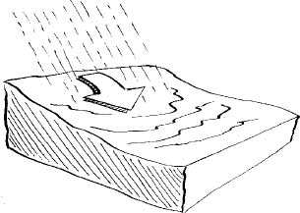
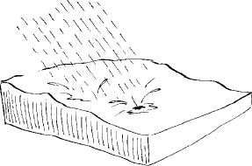
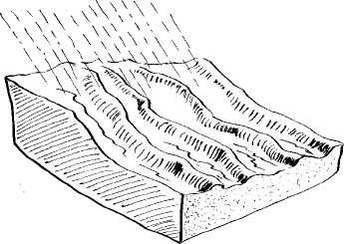
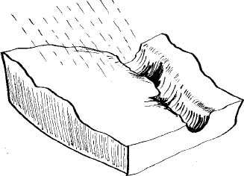
Soil erosion types
Splash erosion
Sheet erosion
Rill erosion
Gully erosion
(non recoverable)

Slide 27
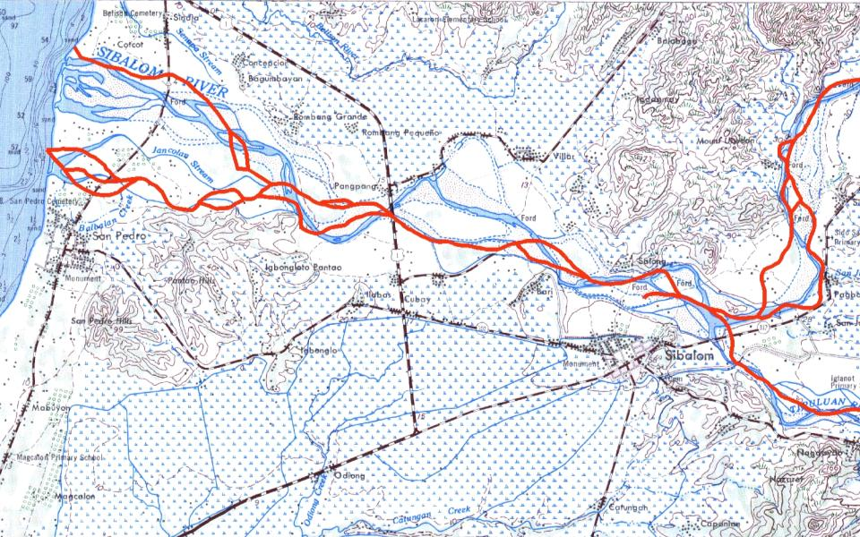
River movement (higher sediment input increases lateral erosion)
Durok
Pang pang
San Pedro
Sibalom
Topomap of 1950s
In RED the 2001 river course
1 kilometer

Slide 28
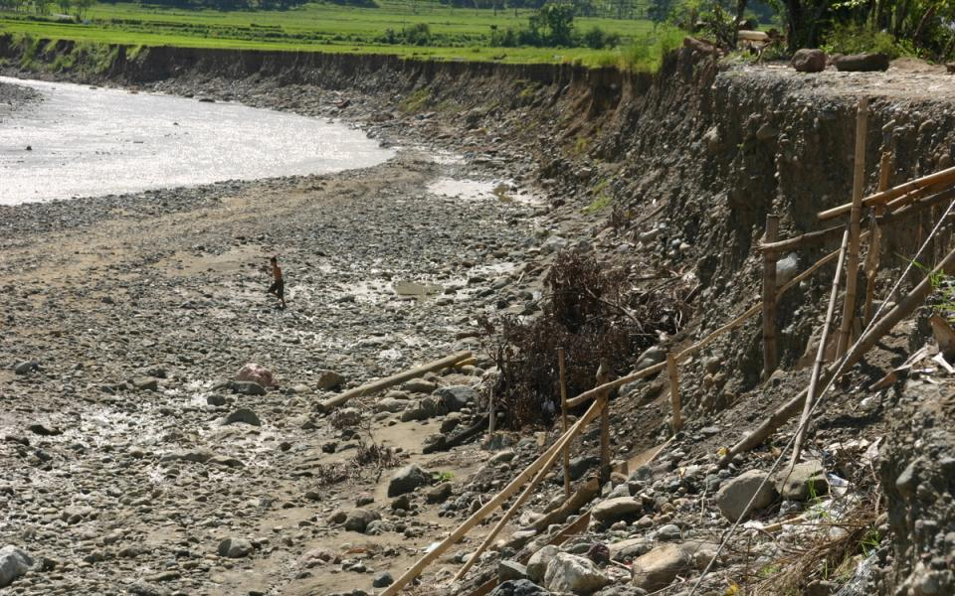
Lateral (sideways) erosion San Remigio

Slide 29
Effects of land cover change
Example

Slide 30
River basin plan
Get insight in the (eco)system
Relate ecosystem services to each other (sustainable use)
Organise the system
Take action
Monitor the system

Slide 31
Simple erosion model
Sheet and rill erosion are included only

Slide 32
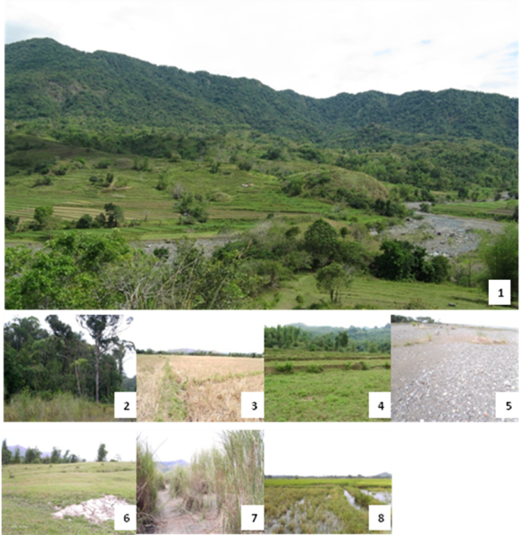
LU types
Overview
Forest
Rice field
Rice terrace
Bare land
Grassland
Bushland
Inland water)

Slide 33
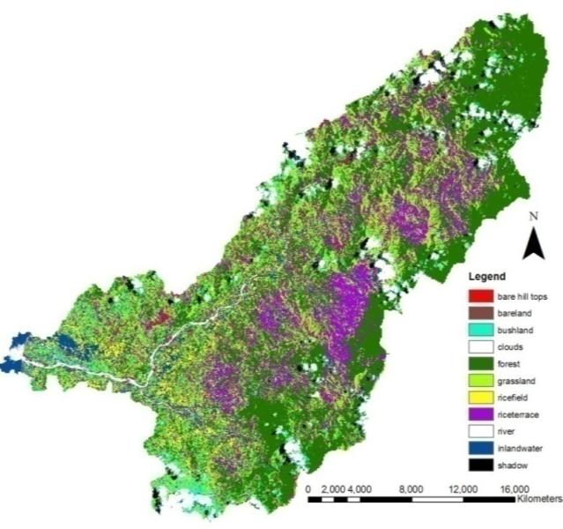
Landuse
Values for C factor influences on erosion
Forest | 0.002
Rice field | 0.15
Rice terrace | 0.15
Bare land | 1
Grassland | 0.007
Bush land | 0.006
Inland water | 0.15

Slide 34
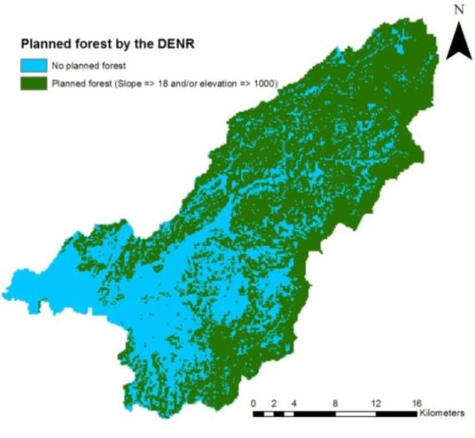
Partly reforested
According to Philippine law the following areas should be reforested:
Uplands above 1 kilometer elevation
Slopes steeper than 18 degrees

Slide 35
Comparing the scenarios
Relative sheet and rill erosion
(partly reforested = 100)
See more on Erosion sensitivity sibalom report

Slide 36
Example: flood risk management
GTZ development project

