Slide 1
Tropical Catchment
Case study Philippines

Slide 2
Contents
River basin action plan (Questions about text)
Introduction Philippines (video clip)
Catchment / Watershed
Tropical watershed landscape (video clip)
Tropical basin use (video clip)
Example management action: flood risk early warning system.

Slide 3
Introduction
Film 1

Slide 4
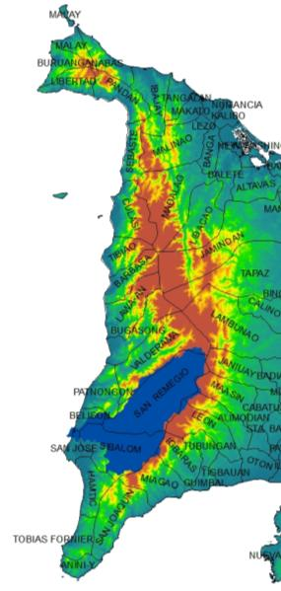
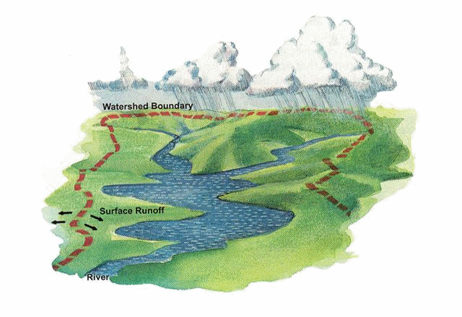
watershed
Notes:
3d pan van watershed op antique bergen.

Slide 5
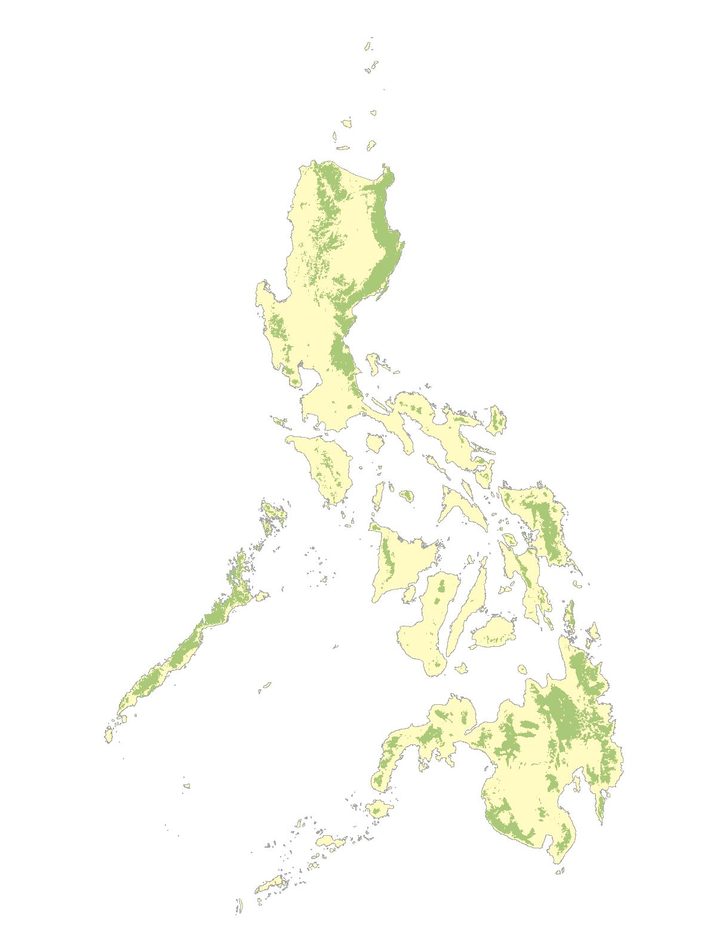
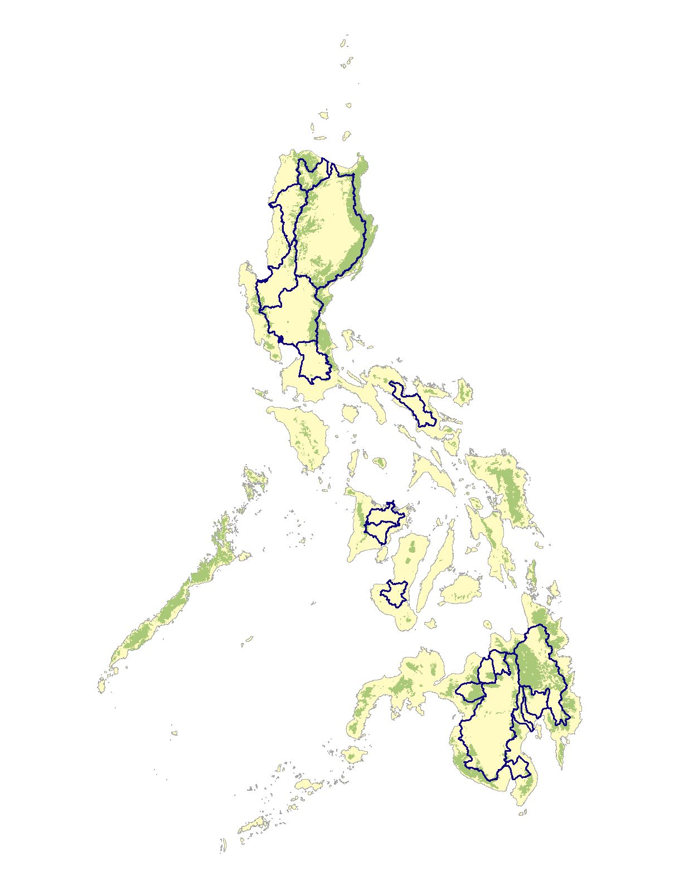





Watersheds

Slide 6
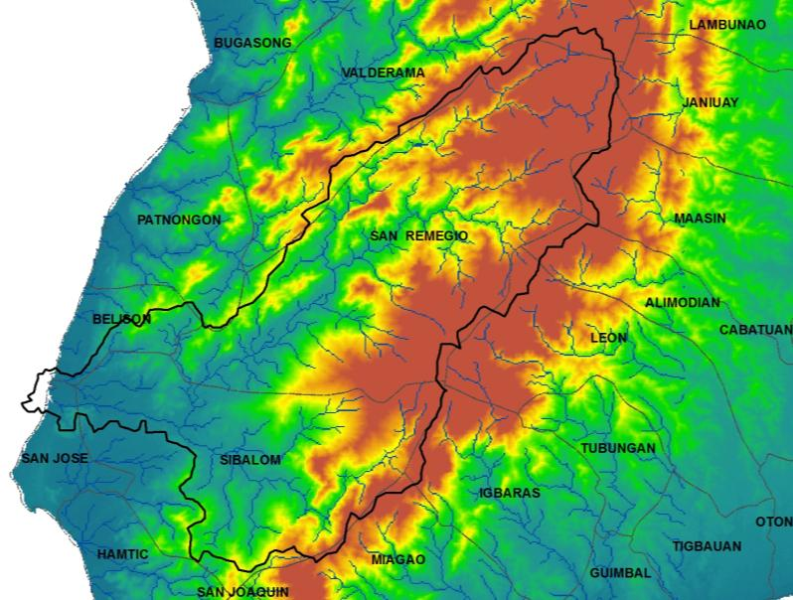
Drainage network
Sulu Sea
Notes:
Titel veranderen: drainage network. Maak duidelijk wat grote en kleine plaatjes zijn.

Slide 7
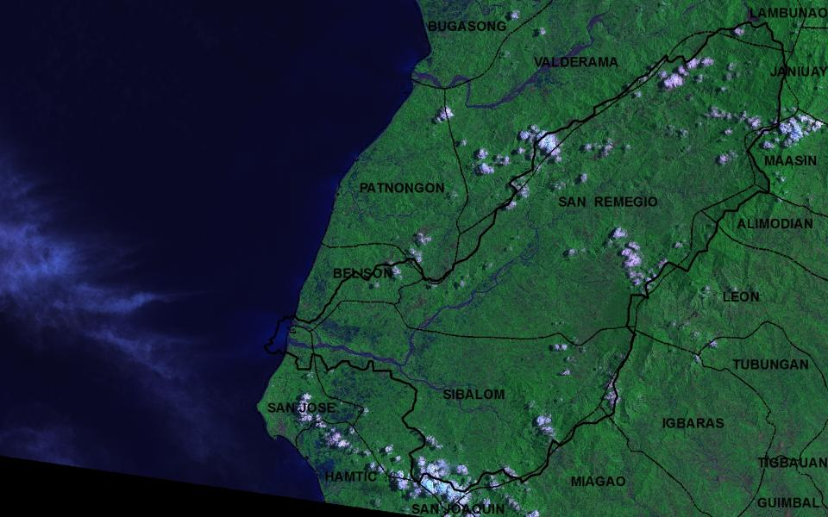
Sibalom watershed – indication of scale
Key facts
Area | 66500 Ha
Highest point in watershed | 1584
Length Sibalom river to source | 70 km
Municipalities (also partly) | 7 / 13 (including Iloilo side)
Barangays (also partly) | 135
Sulu Sea

Slide 8
Watershed landscape
Film 2

Slide 9
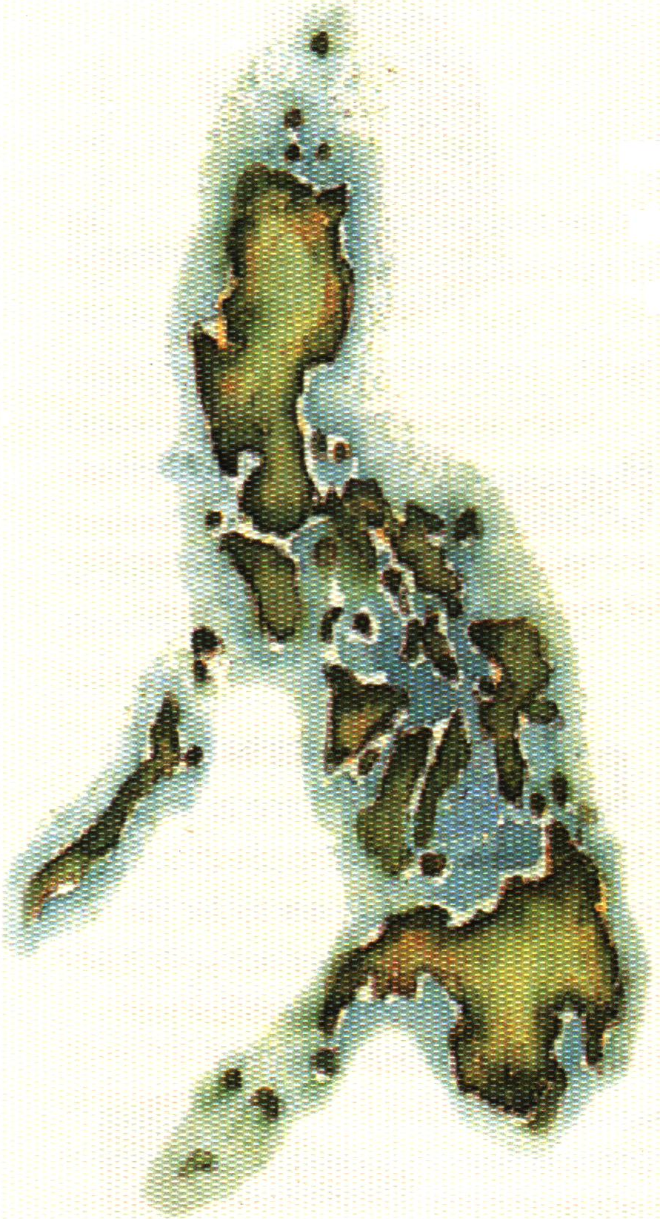
Philippines
LAND USE STATUS
Forest land 18.1%
Residual
forests
2,731,177 ha
(includes forests on ultramafic and limestone rocks)
Sub marginal forests
475,100 ha
Brush land 7.4%
Mangrove forests
112,400 ha
(includes brackish water forests)
(includes lowland evergreen, semi-evergreen, and moist deciduous rain forests)
Other Land use 74.5%
Mossy forests
1,040,300 ha
(includes the upper montane and subalpine rain forests)
Pine forests
227,900 ha
(lower montane rain forests)
Forest Formations
in the Philippines
Old growth forests
804,900 ha
(lowland evergreen rain forests)
DENR FMB 2000
based on 1997 data

Slide 10
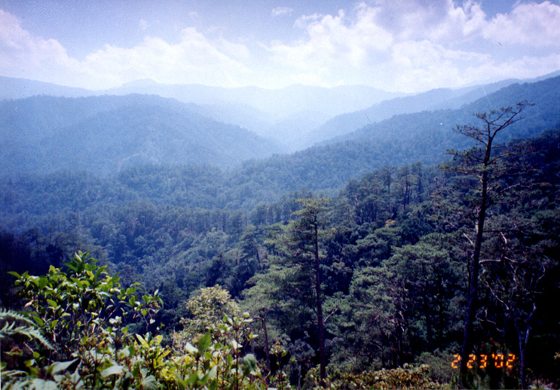
Major Watersheds
The Philippines has 18 identified major river basins
13 out of 18 major river basins have forest cover below 20% of its total area

Slide 11
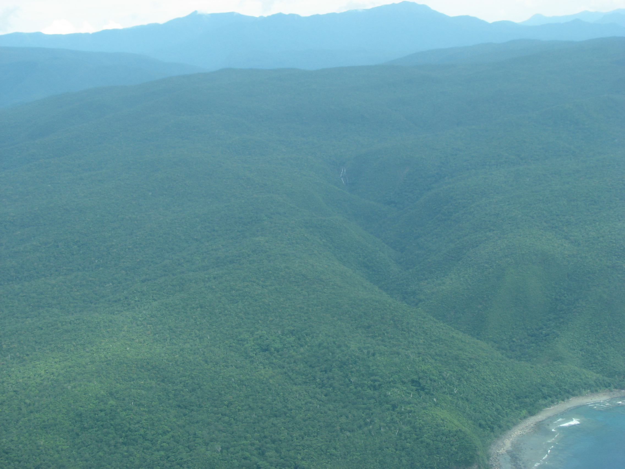

Slide 12
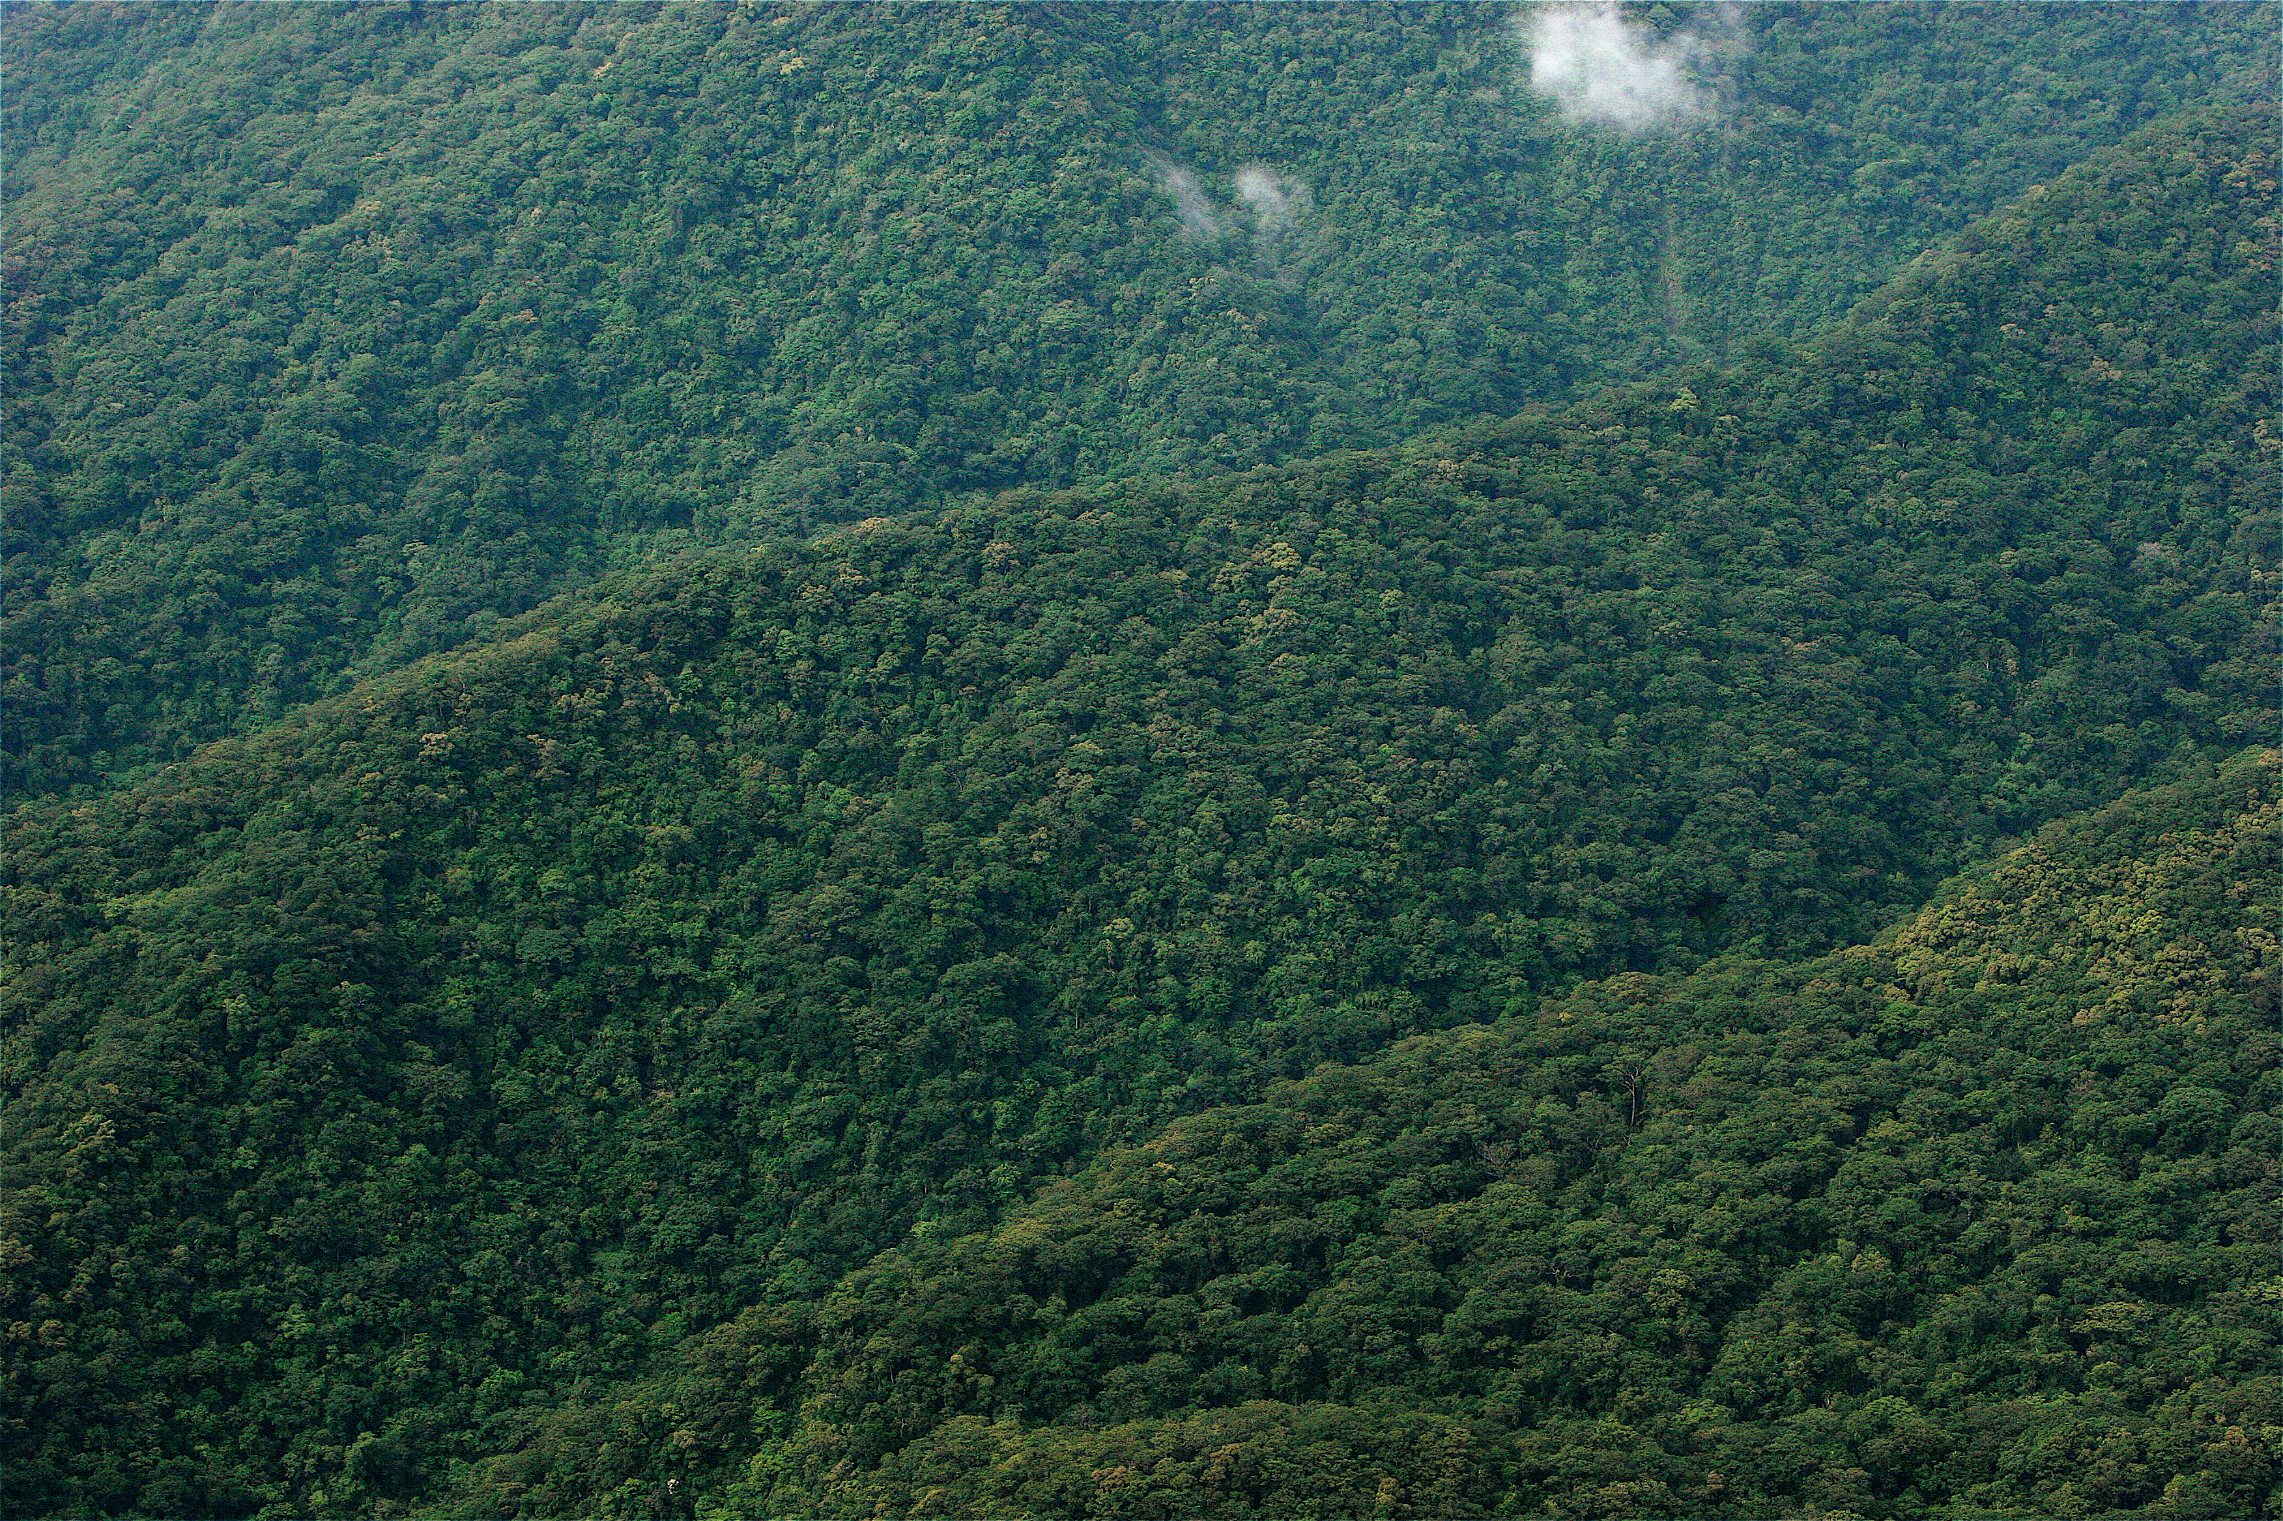

Slide 13
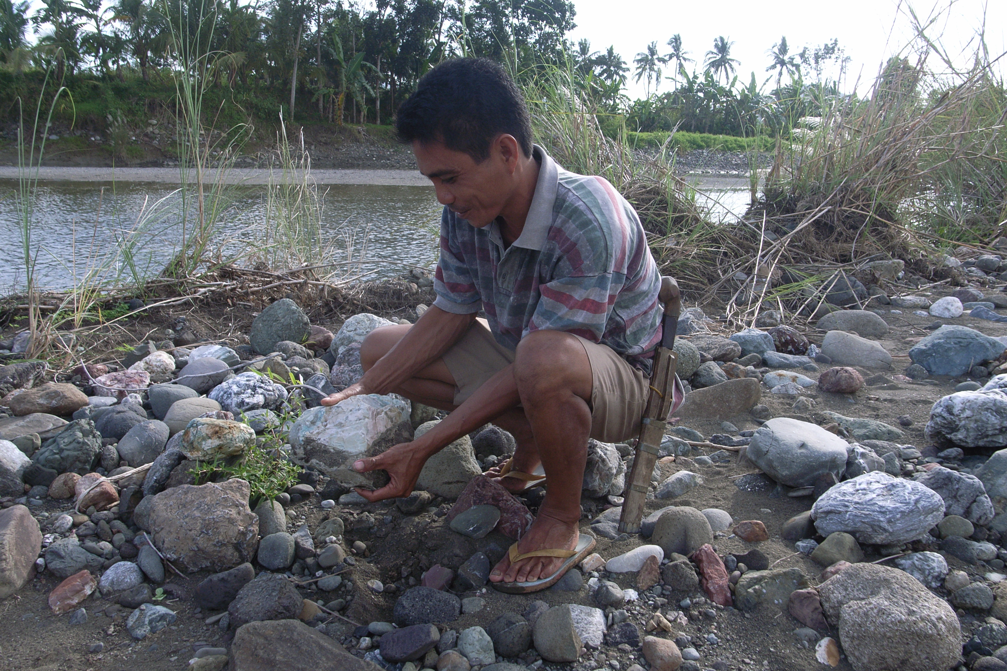
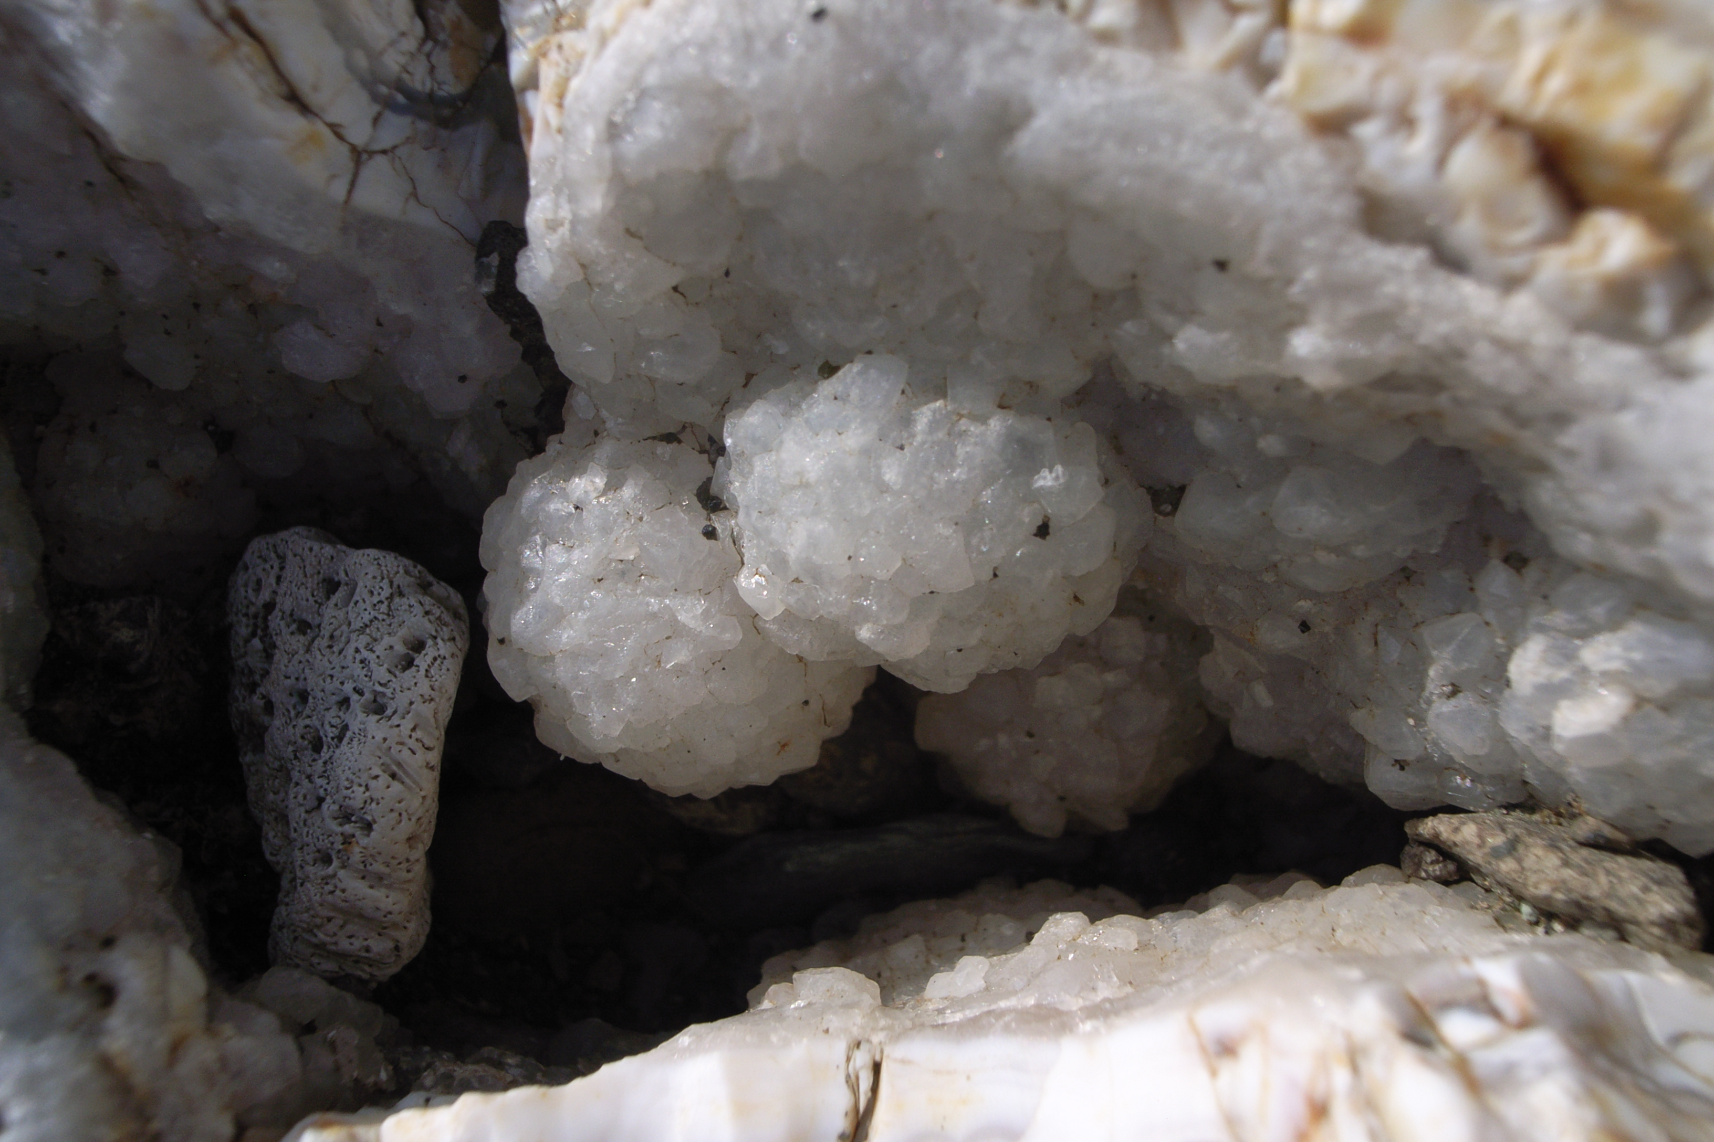
Ecosystem services
Gemstone gathering

Slide 14
Ecosystem services
Film 3

Slide 15
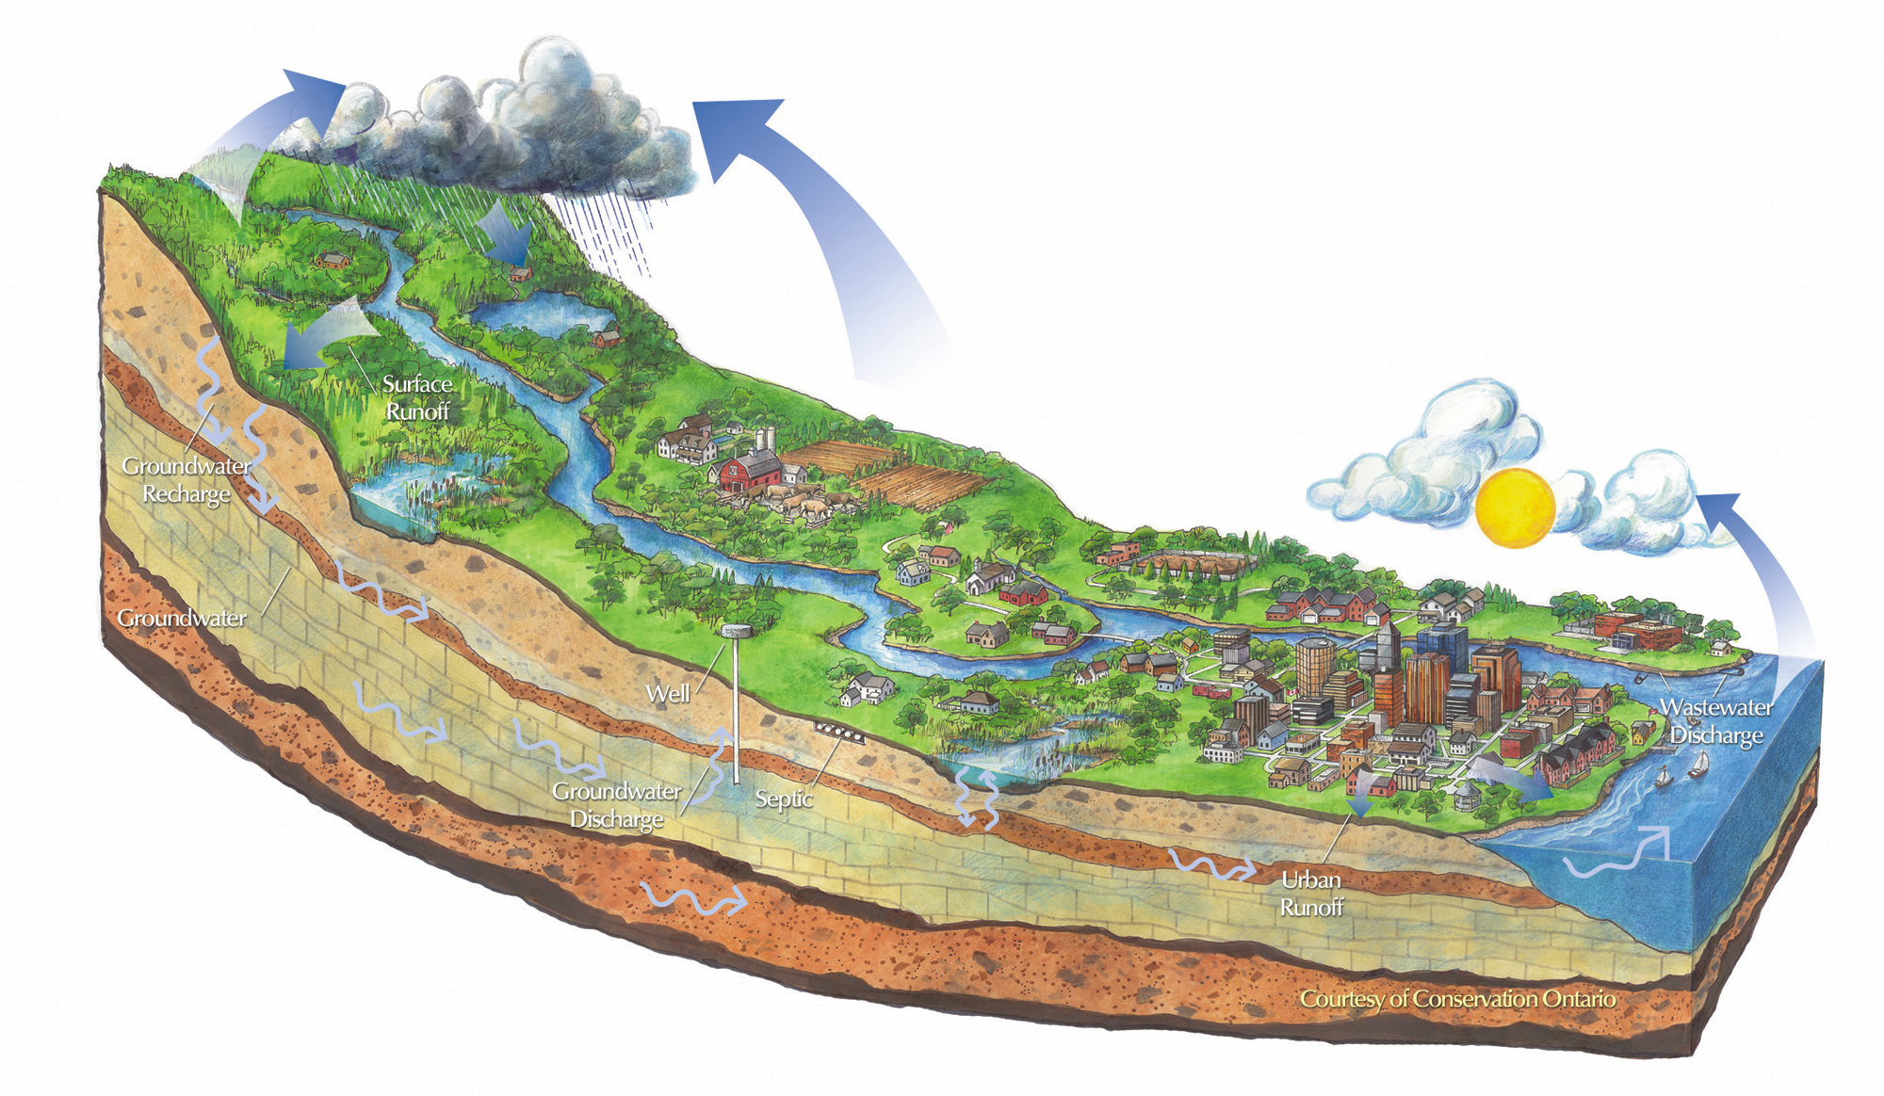
Watershed sevices

Slide 16
Watershed sevices

Slide 17
Watershed sevices

Slide 18
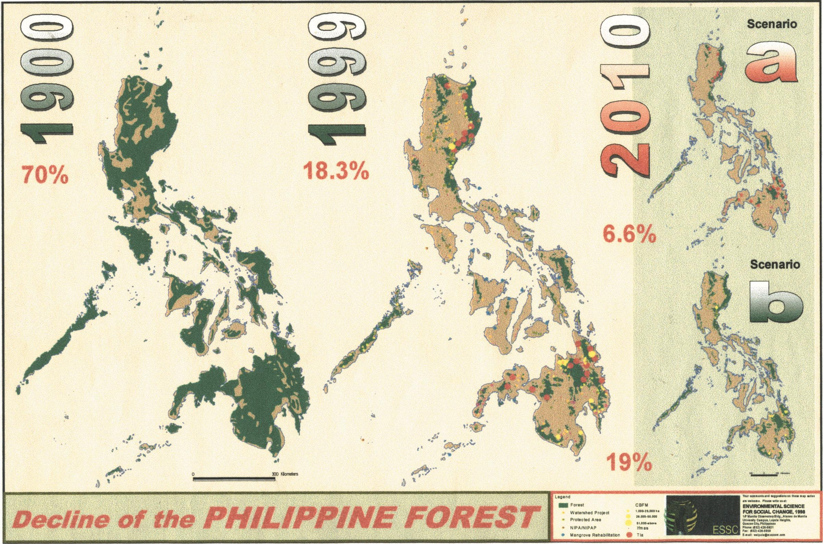

Slide 19
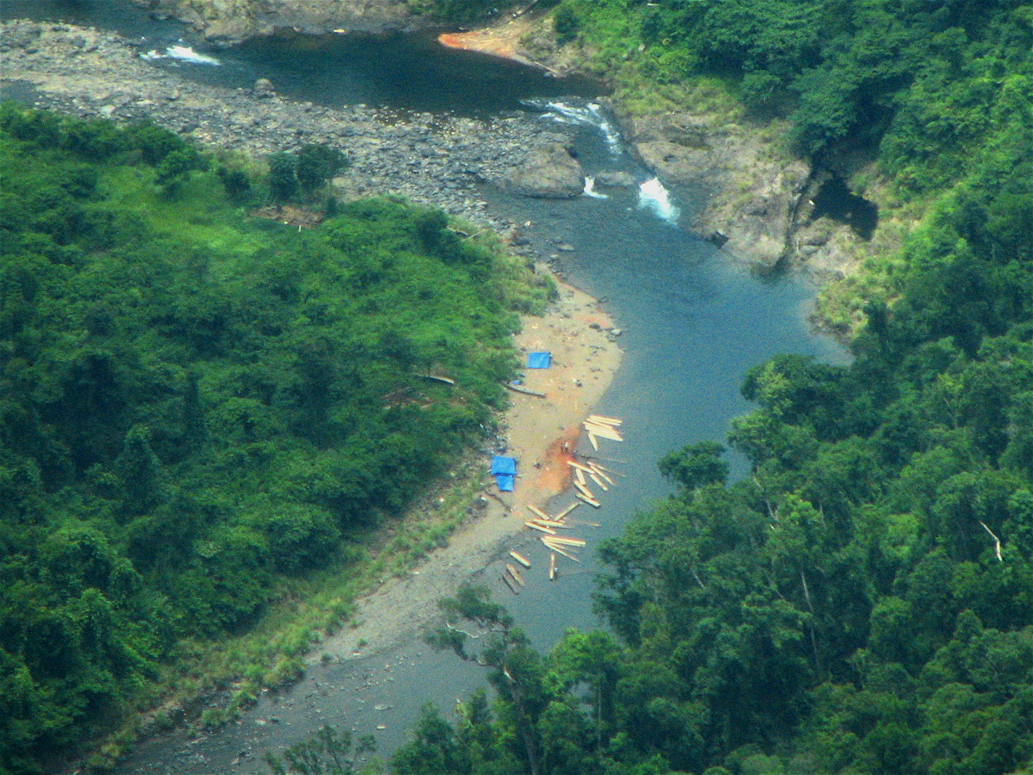
Illegal logging

Slide 20
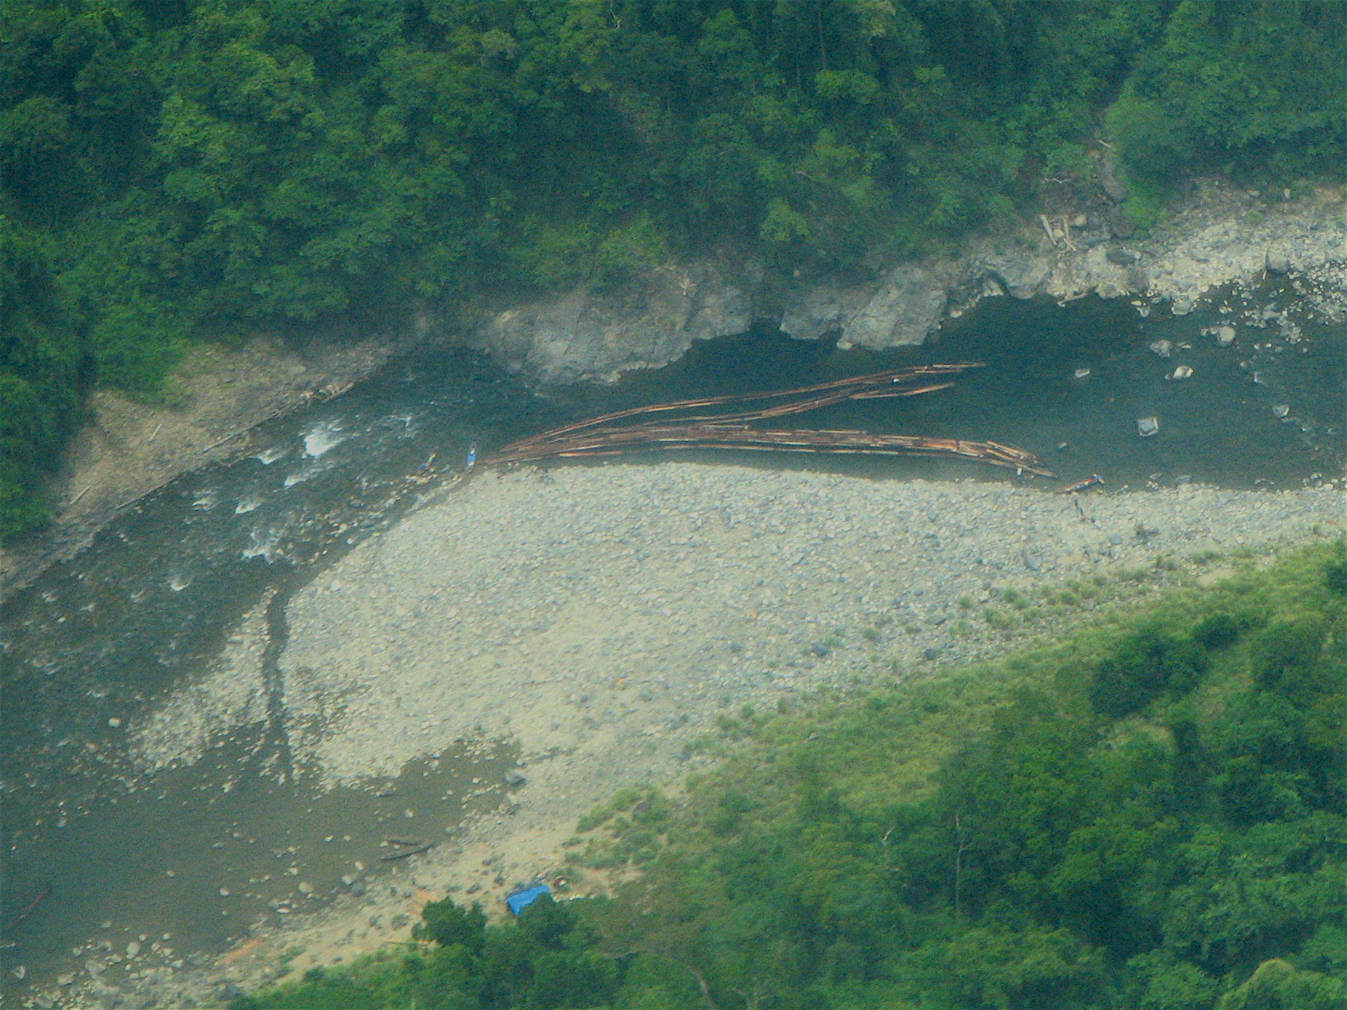
Illegal logging

Slide 21
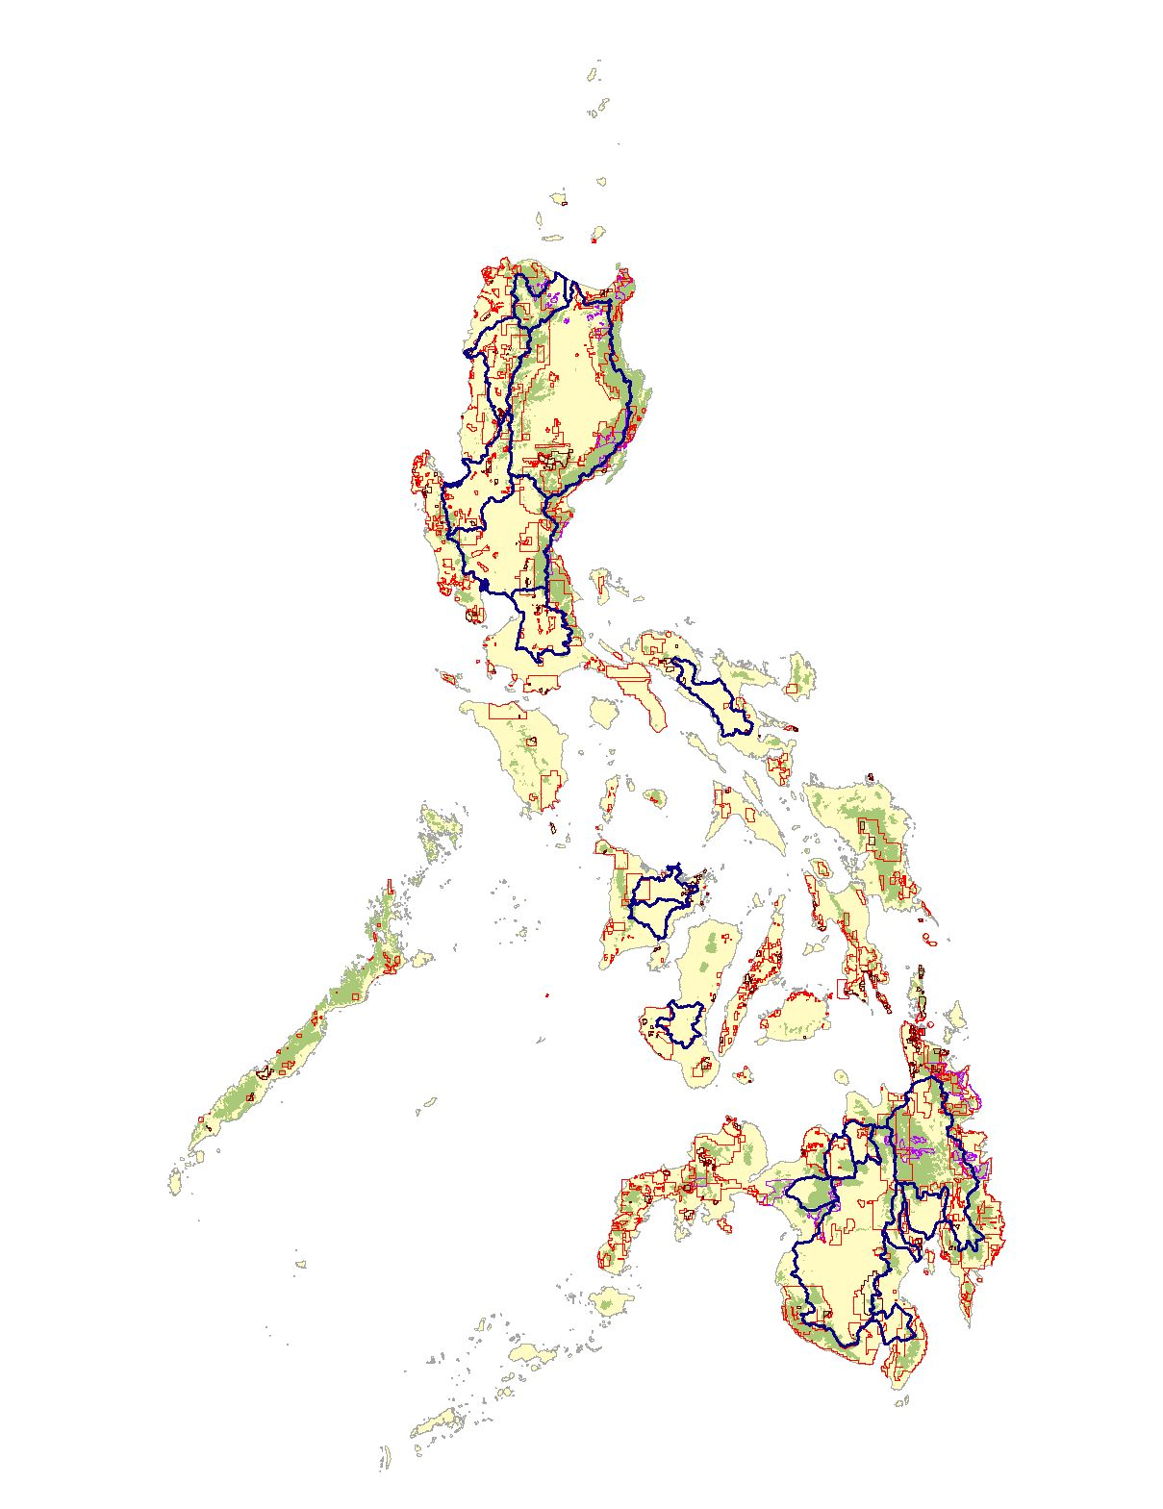
Watersheds & Mining
Mining concessions

Slide 22
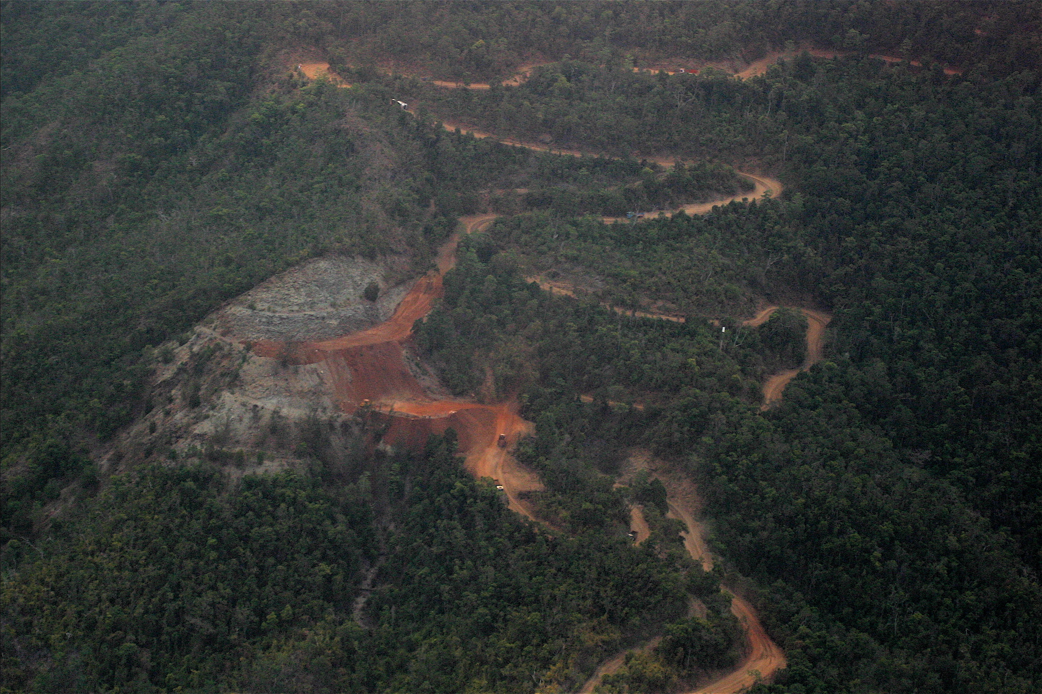

Slide 23
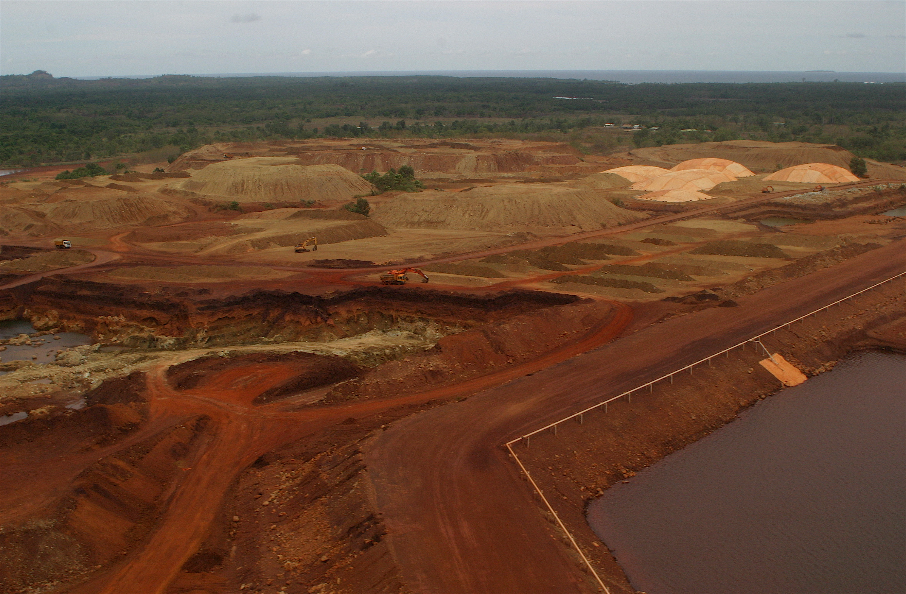

Slide 24
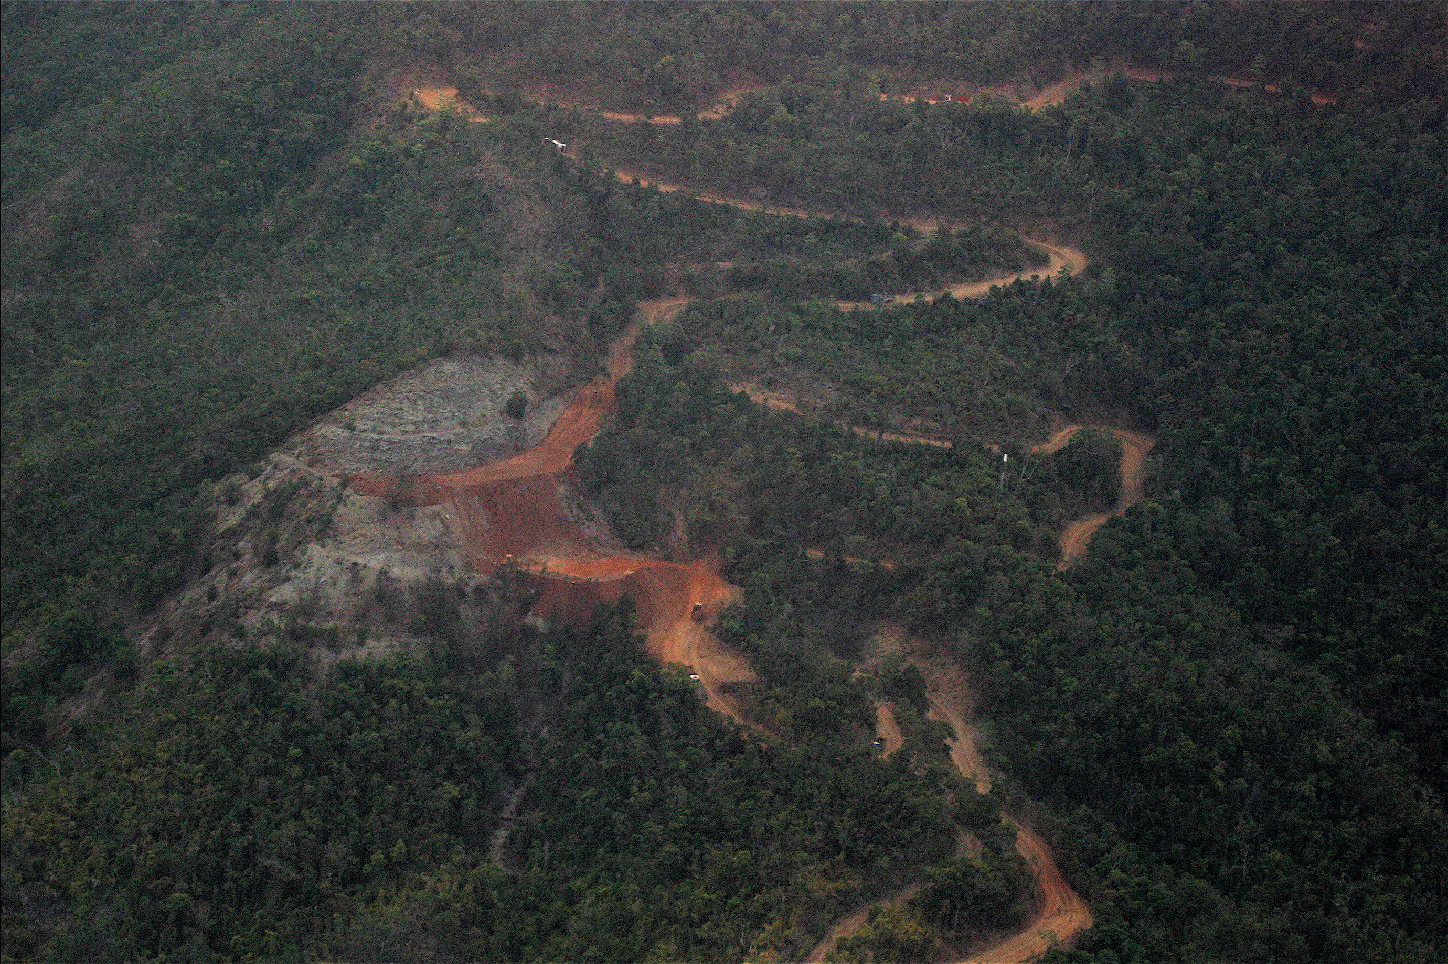
Small Scale Mining Operation

Slide 25
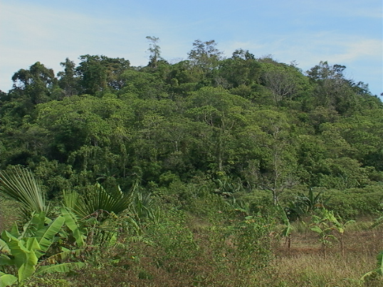
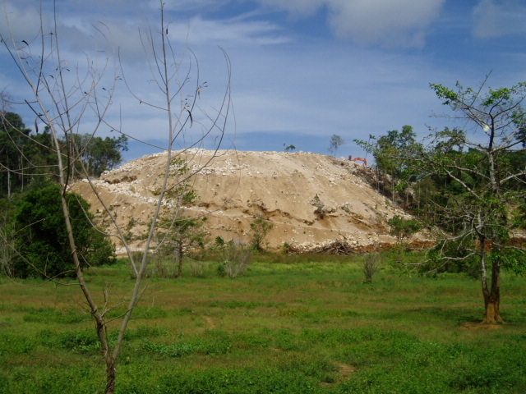
Limestone Quarry Site
Before
Now
See more on Mining powerpoint on ftp drive (Toine)

Slide 26
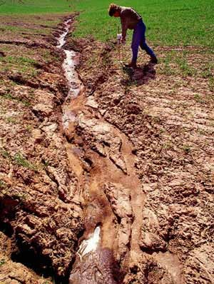
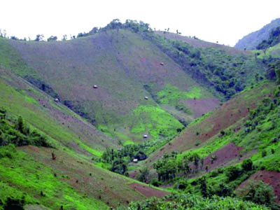
Soil erosion
Soil erosion depletes soil productivity for future generations.
Soil erosion increases the sediment carried by rivers, and can increase its lateral movement.
Soil erosion blocks downstream irrigation channels.
Soil erosion increases sediment input in coastal areas, causing siltation that affects for example coral reefs.
….... (more?)

Slide 27
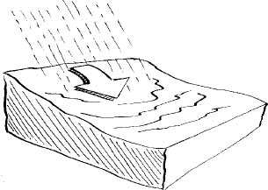
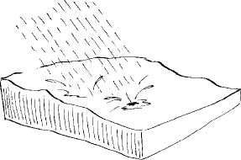
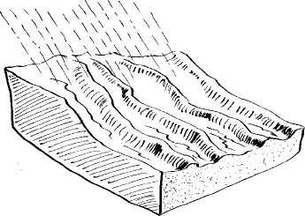
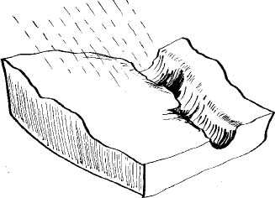
Soil erosion types
Splash erosion
Sheet erosion
Rill erosion
Gully erosion
(non recoverable)

Slide 28
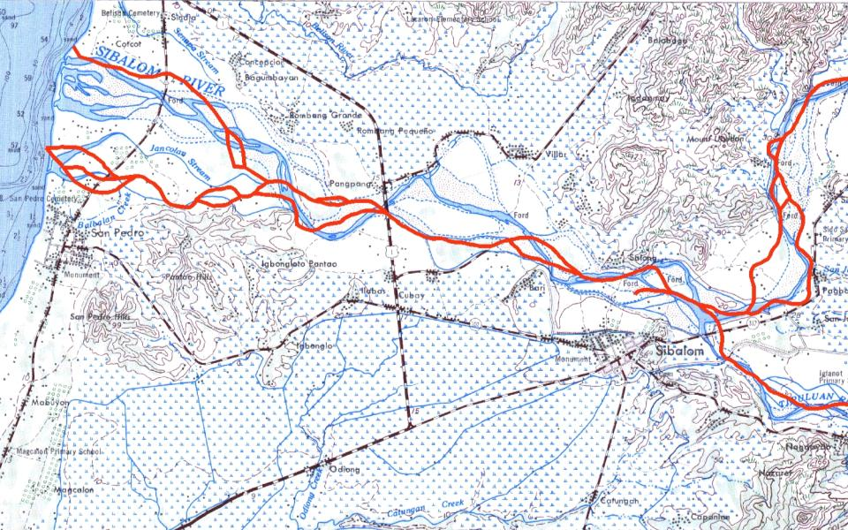
River movement (higher sediment input increases lateral erosion)
Durok
Pang pang
San Pedro
Sibalom
Topomap of 1950s
In RED the 2001 river course
1 kilometer

Slide 29
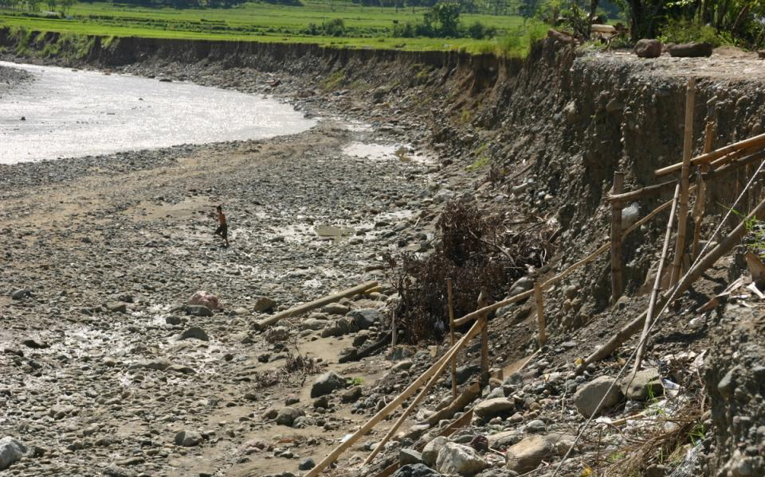
Lateral (sideways) erosion San Remigio

Slide 30
Effects of land cover change
Land cover change: forest and mangrove decline, mining
Increase in run off and soil erosion (forest cover) and siltation function of mangrove stands has disappeared
Siltation of adjacent coral reefs
Example

Slide 31
River basin plan
Get insight in the (eco)system
Relate ecosystem services to each other (sustainable use)
Organise the system
Take action
Monitor the system

Slide 32
Get insight: simple erosion model
Soil Erosion
Soil type
Land use
Rain
Slope
Prevention
Sheet and rill erosion are included only

Slide 33
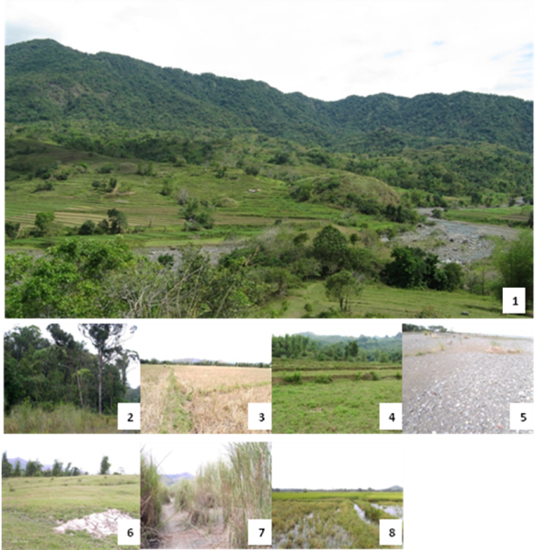
LU types
Overview
Forest
Rice field
Rice terrace
Bare land
Grassland
Bushland
Inland water)

Slide 34
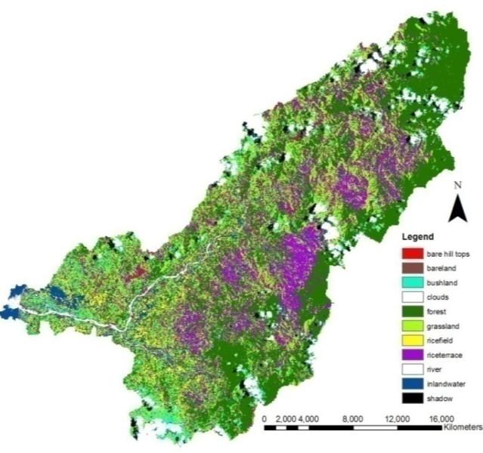
Landuse
Values for C factor influences on erosion
Forest | 0.002
Rice field | 0.15
Rice terrace | 0.15
Bare land | 1
Grassland | 0.007
Bush land | 0.006
Inland water | 0.15

Slide 35
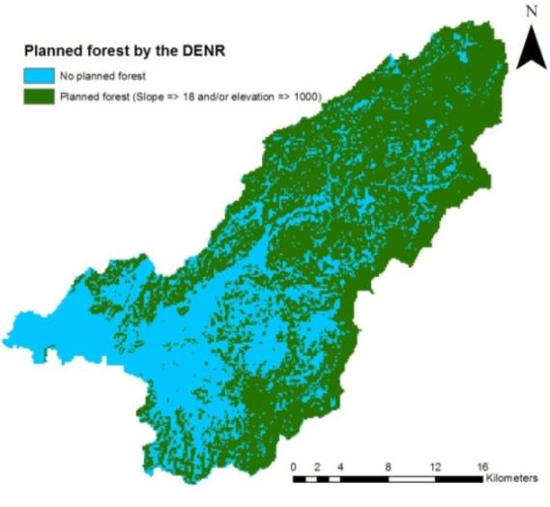
Partly reforested
According to Philippine law the following areas should be reforested:
Uplands above 1 kilometer elevation
Slopes steeper than 18 degrees

Slide 36
Comparing the scenarios
Relative sheet and rill erosion
(partly reforested = 100)
Burgers, 2009. Spatial modelling of soil loss within the Sibalom catchment, The Philippines. MSc. Thesis. DSMR, Nijmegen.

Slide 37
Example: flood risk management
GTZ development project

